Slide 1
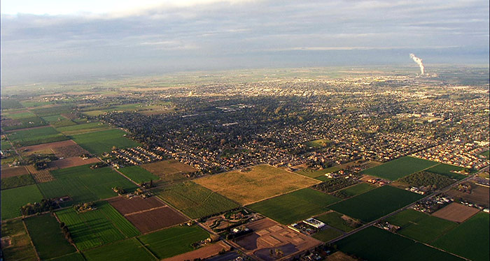
City of Turlock
Redistricting Draft Maps
Dr. Jeff Tilton, Senior Consultant
National Demographics Corporation

Slide 2
Redistricting Process
Step | Description
Census Data Releases | Census Bureau releases official 2020 Census population data – Aug. 12 California’s official ‘prisoner-adjusted’ 2020 redistricting data – Sept. 21, 27
Public Hearing October 18, 2021 | Staff facilitated Held prior to release of draft maps Educate, solicit input on the communities in the Districts
Public Hearing November 8, 2021 | Held prior to release of draft maps Educate, solicit input on the communities in the Districts
Public Hearing January 25, 2022 | Discuss, revise draft maps
Public Hearing March 22, 2022 | Discuss, determine final map; discuss, determine election sequencing First reading of ordinance
Dates/times subject to change

Slide 3
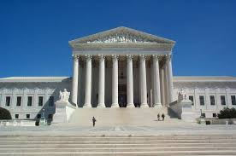
Redistricting Rules and Goals
Federal Laws
California Criteria
for Cities
Other Traditional Redistricting Principles
Equal Population
Federal Voting Rights Act
No Racial Gerrymandering
Geographically contiguous
Undivided neighborhoods and “communities of interest”
Easily identifiable boundaries
Compact
Prohibited: “Shall not favor or discriminate against a political party.”
Minimize voters shifted to different election years
Respect voters’ choices / continuity in office
Future population growth
Preserving the core of existing districts

Slide 4
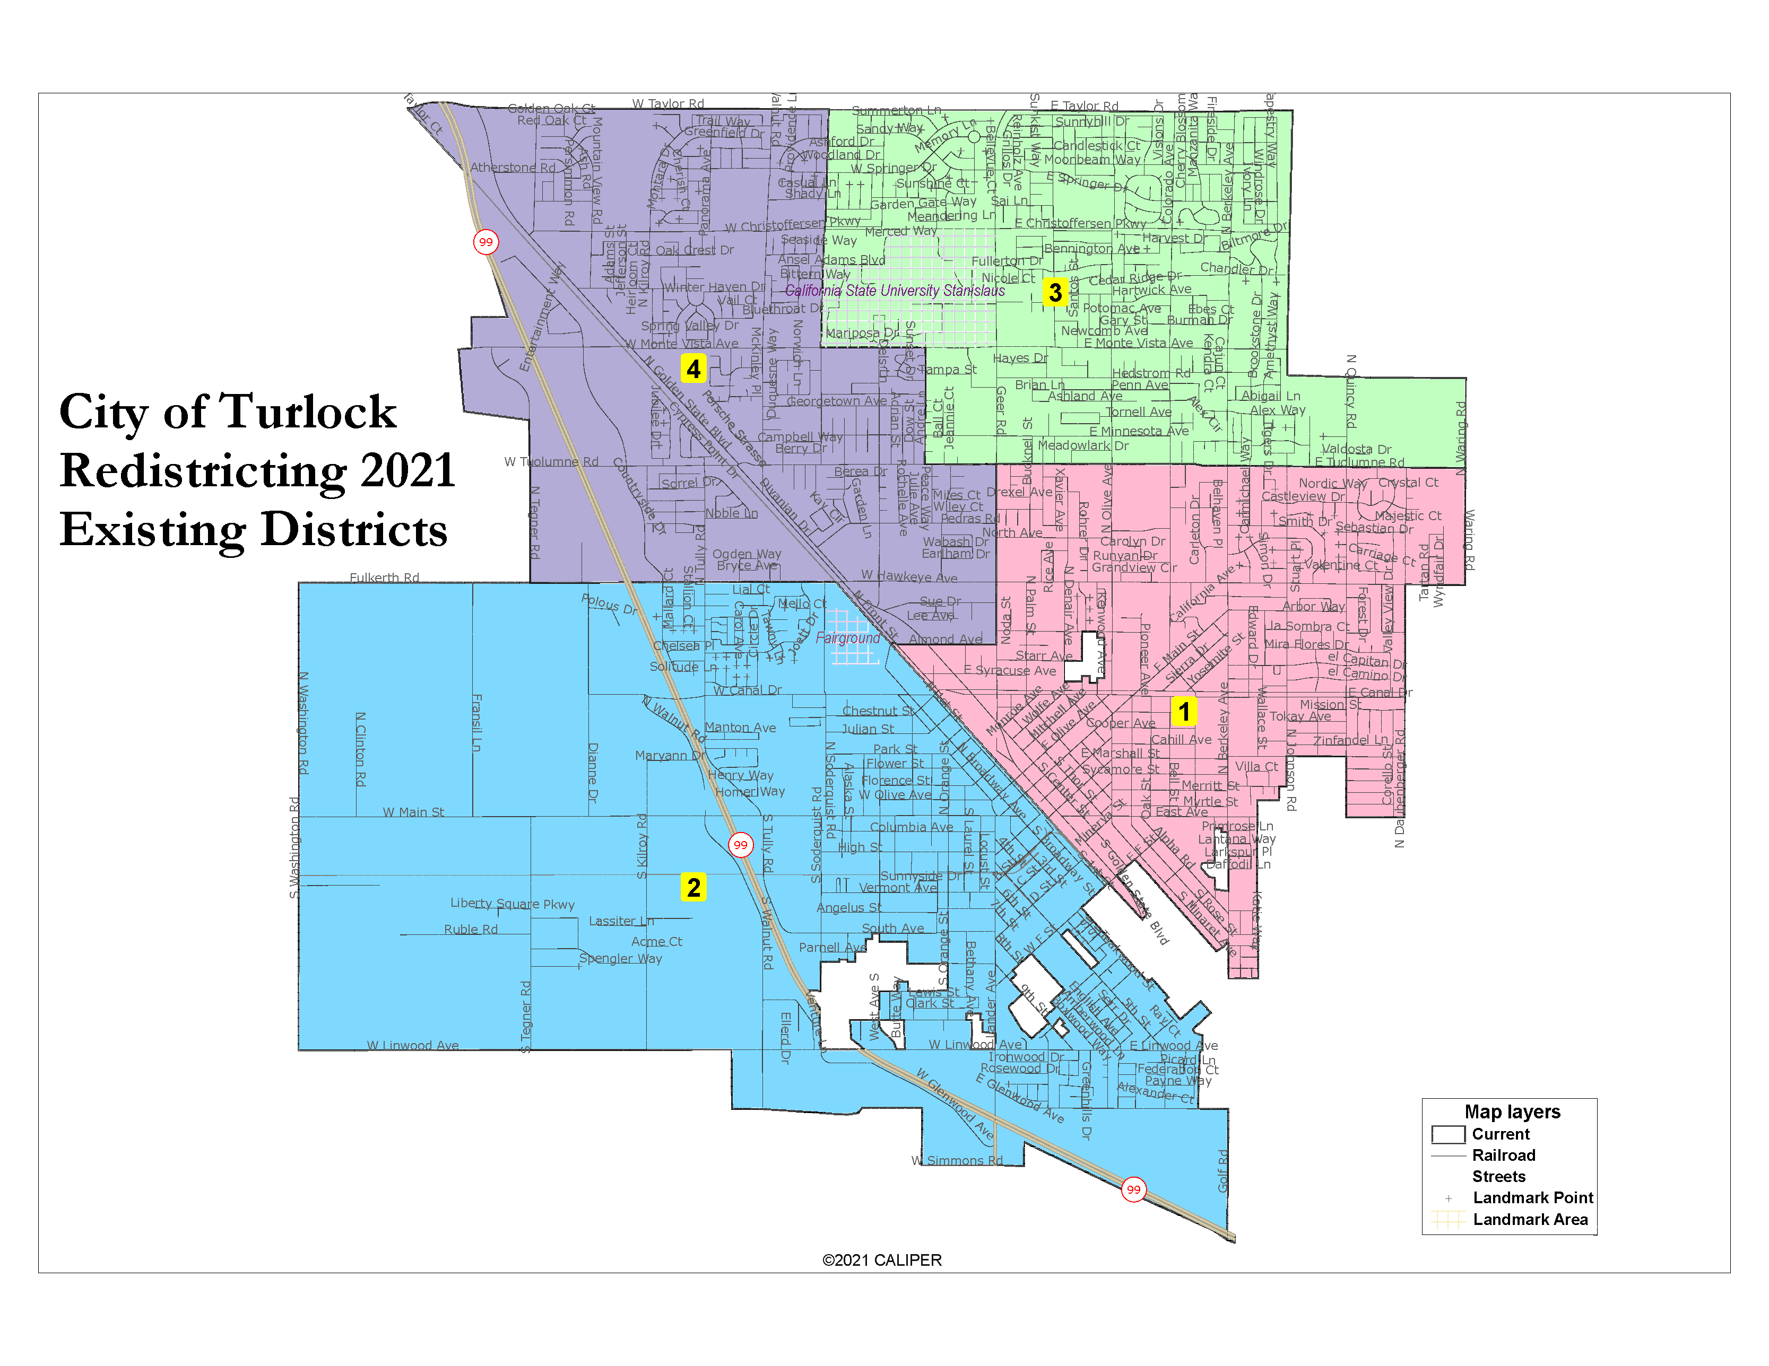
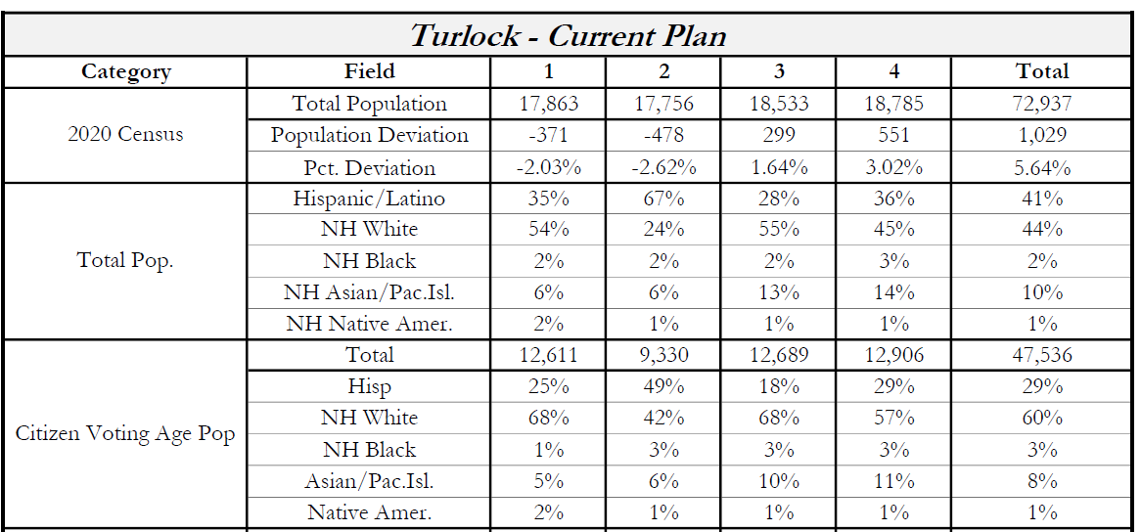
2020 Census
Ideal per District: 18,234

Slide 5
Neighborhoods/Communities of Interest
Neighborhoods
What is your neighborhood?
What are its geographic boundaries?
In the absence of public testimony, planning records and other similar documents may provide definition.
Communities of Interest
What defines your community?
Would this community benefit from being “included within a single district for purposes of its effective and fair representation”?
Communities of Interest may not include relationships with political parties, incumbents, or political candidates.

Slide 6
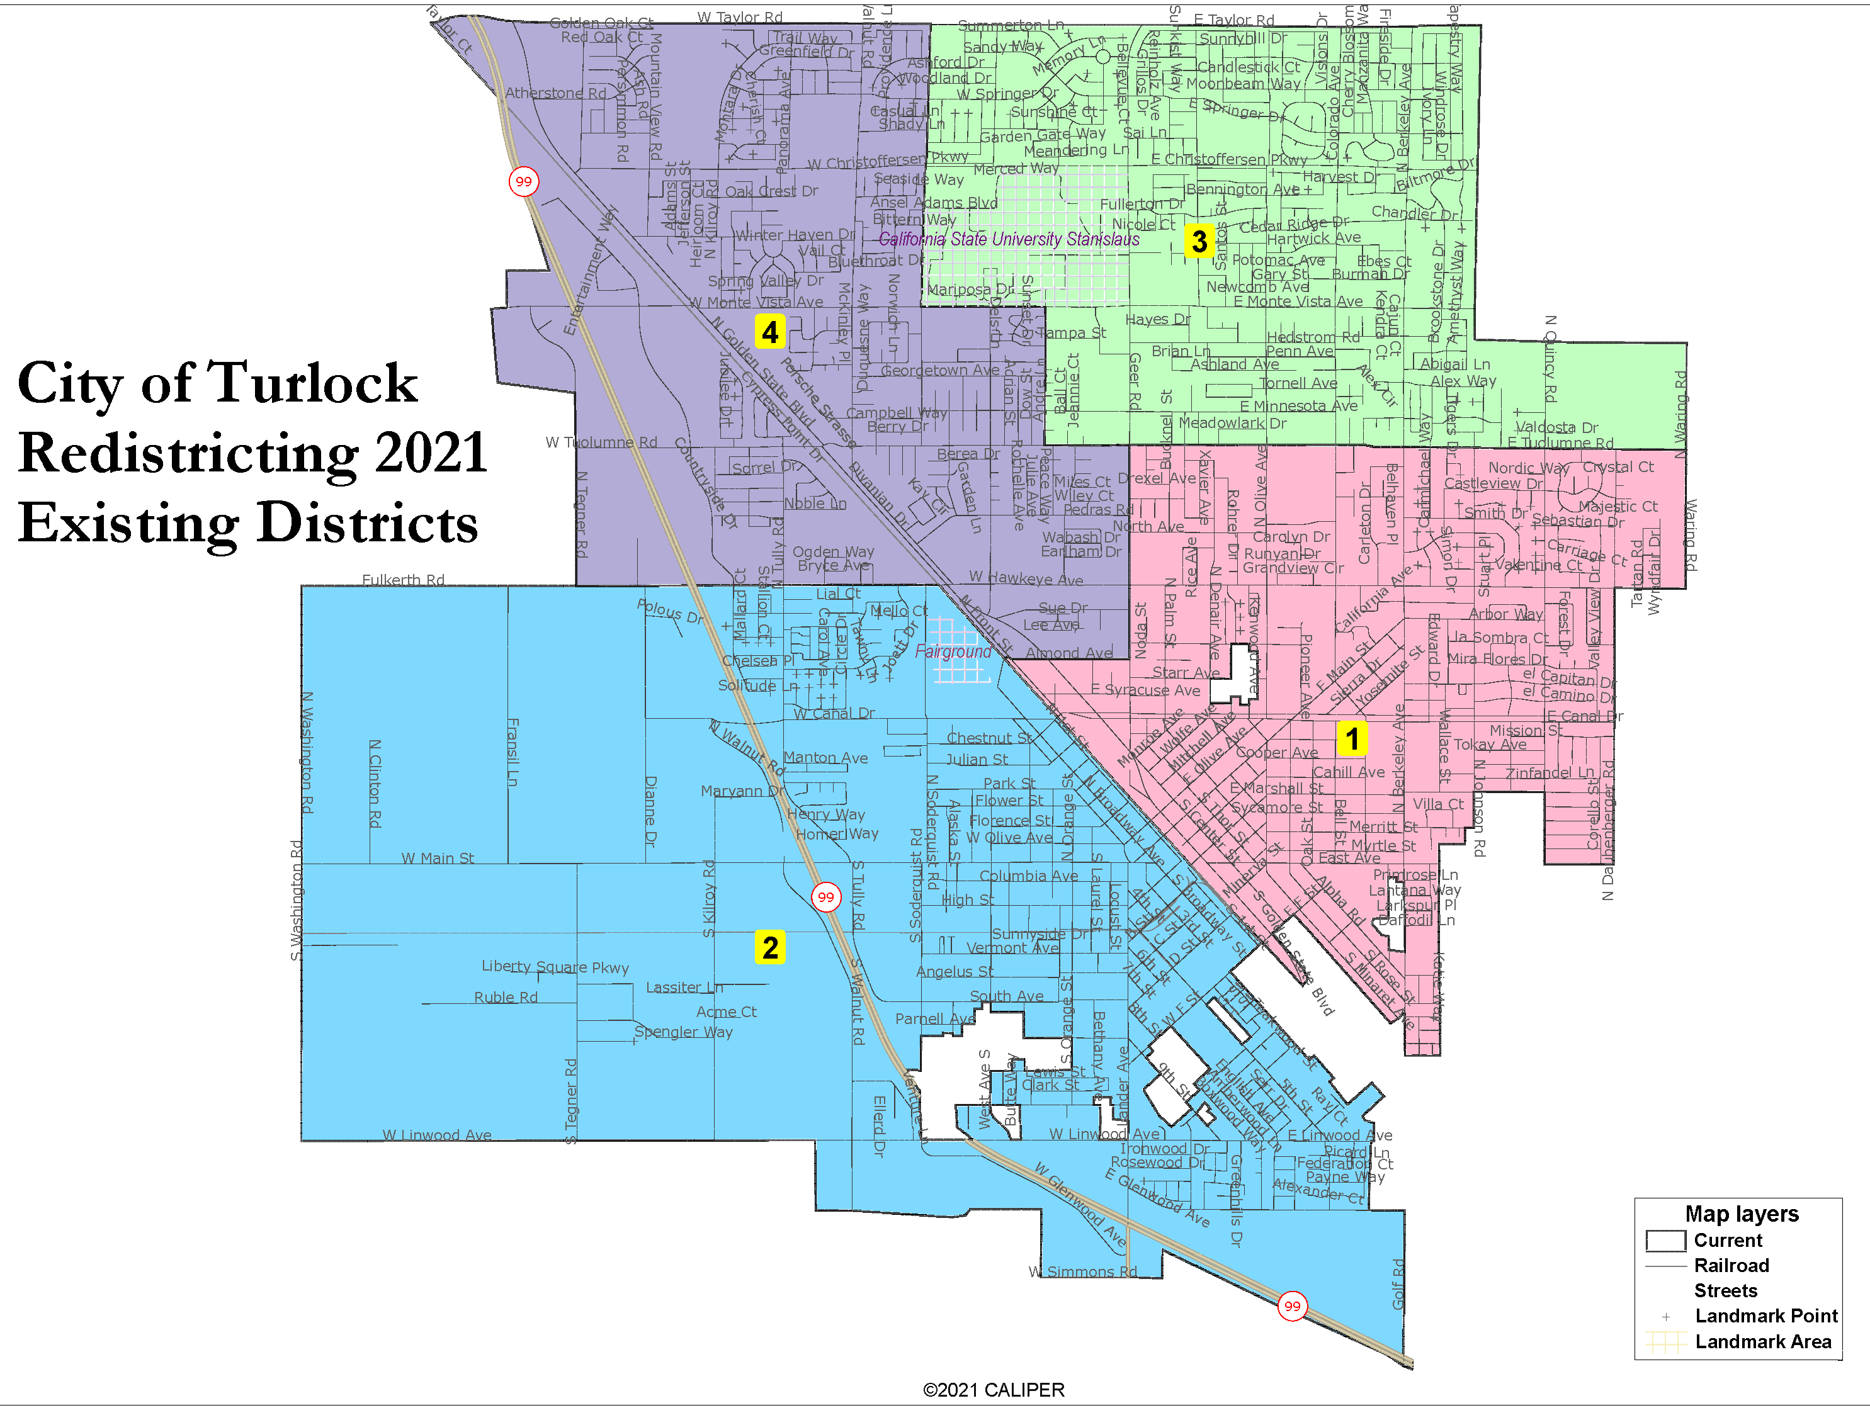
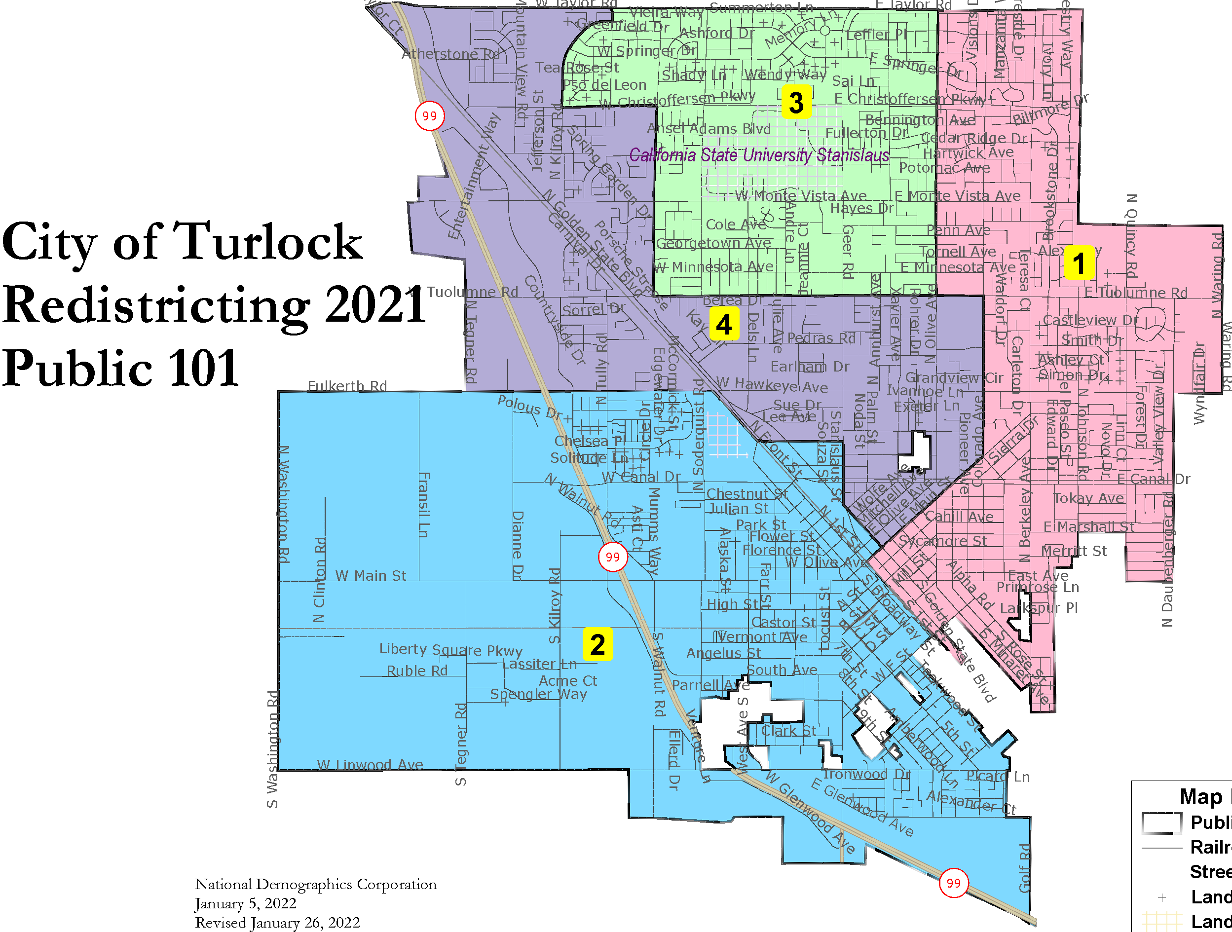
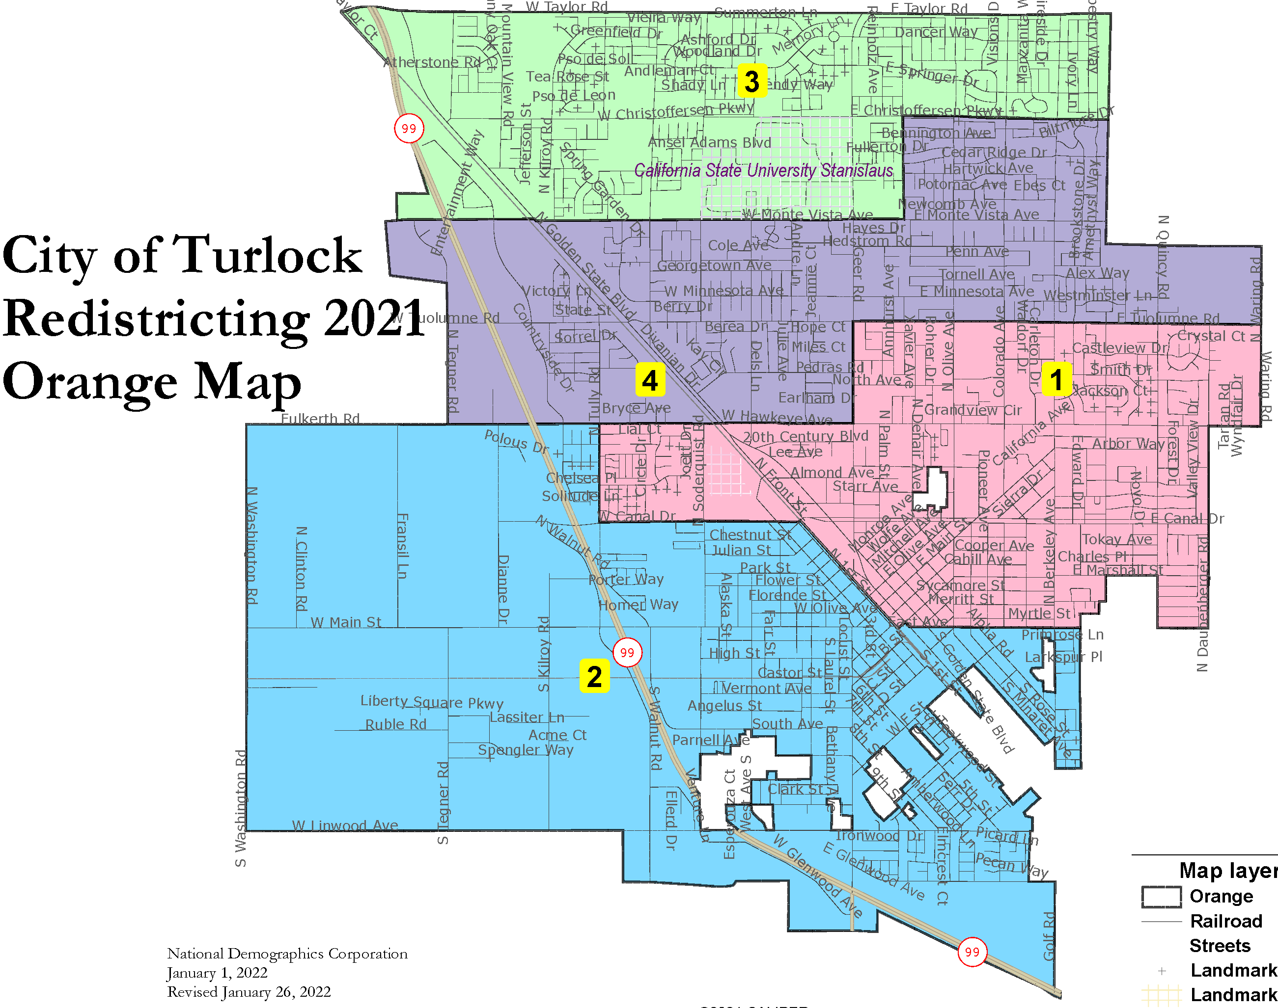
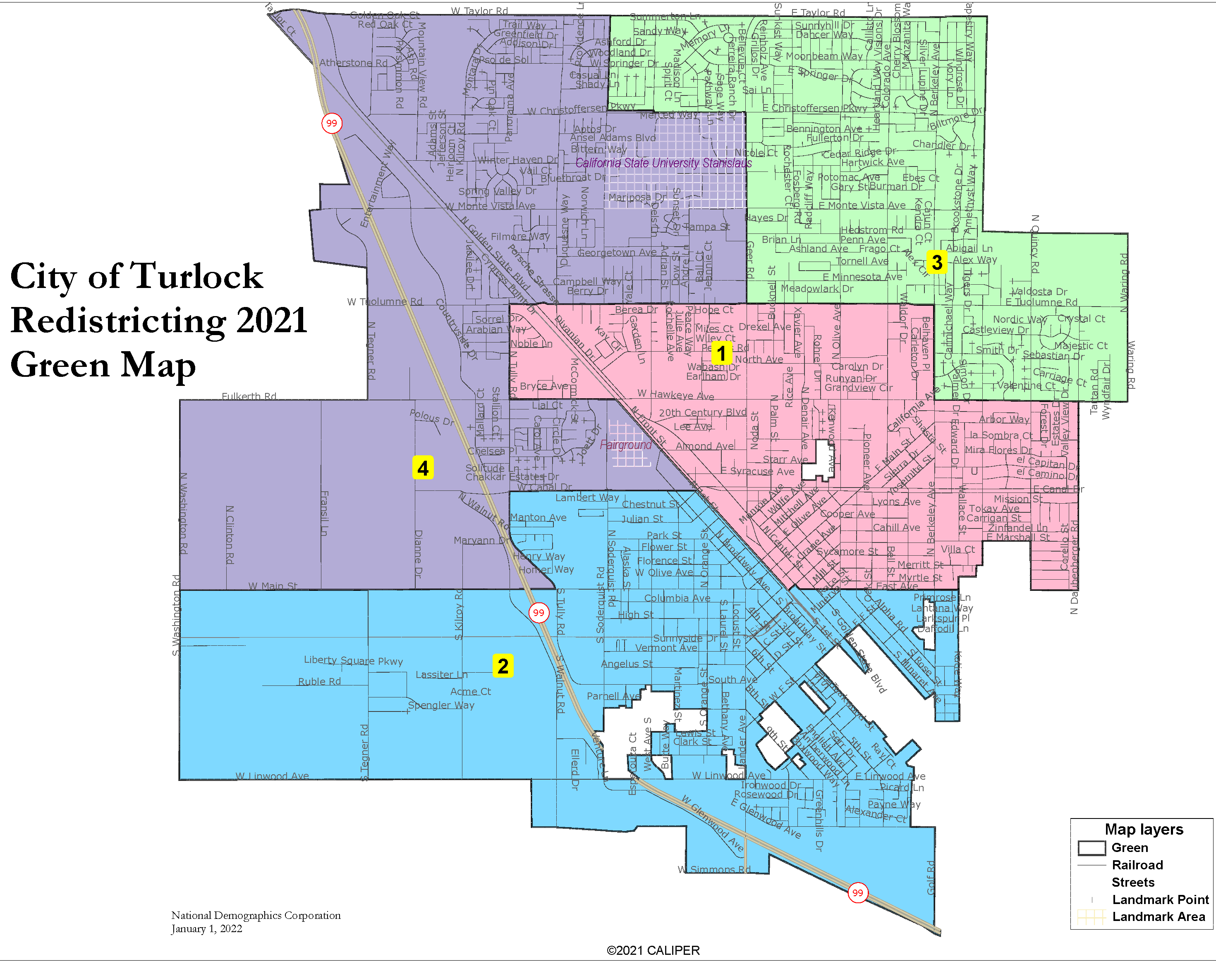
The Draft Maps

Slide 7
Deviation: 5.64%
Pairs no
Council Members
No LCVAP districts

Slide 8
Deviation: 1.14%
Pairs no
Council Members
No LCVAP districts

Slide 9
Deviation: 1.68%
Pairs no
Council Members
One LCVAP district

Slide 10
Deviation: 8.37%
Pairs no
Council Members
One LCVAP district

Slide 11
Public Hearing / Action

