Slide 1
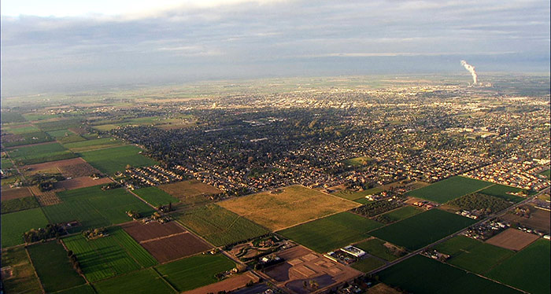
City of Turlock
Introduction to Redistricting
Dr. Jeff Tilton, Senior Consultant
National Demographics Corporation

Slide 2
Redistricting Process
Step | Description
Census Data Releases | Census Bureau releases official 2020 Census population data – Aug. 12 California’s official ‘prisoner-adjusted’ 2020 redistricting data – Sept. 21, 27
Public Hearing October 18, 2021 | Staff facilitated Held prior to release of draft maps Educate, solicit input on the communities in the Districts
Public Hearing November 8, 2021 | Held prior to release of draft maps Educate, solicit input on the communities in the Districts
Public Hearing January 25, 2022 | Public Hearing: 6:30 p.m. Discuss, revise draft maps Deadline to submit draft maps: January 11, 2022, 5 p.m.
Public Hearing March 22, 2022 | Public Hearing: 6:30 p.m. Discuss, determine final map; discuss, determine election sequencing Deadline to submit draft maps: March 8, 2022, 5 p.m. Draft maps posted deadline: March 15, 2022, 5 p.m.
Dates/times subject to change

Slide 3
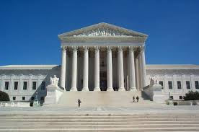
Redistricting Rules and Goals
1. Federal Laws
2. California Criteria for
Cities
3. Other Traditional Redistricting Principles
Equal Population
Federal Voting Rights Act
No Racial Gerrymandering
Geographically contiguous
Undivided neighborhoods and “communities of interest”
Easily identifiable boundaries
Compact
Prohibited: “Shall not favor or discriminate against a political party.”
Minimize voters shifted to different election years
Respect voters’ choices / continuity in office
Future population growth
Preserving the core of existing districts

Slide 4
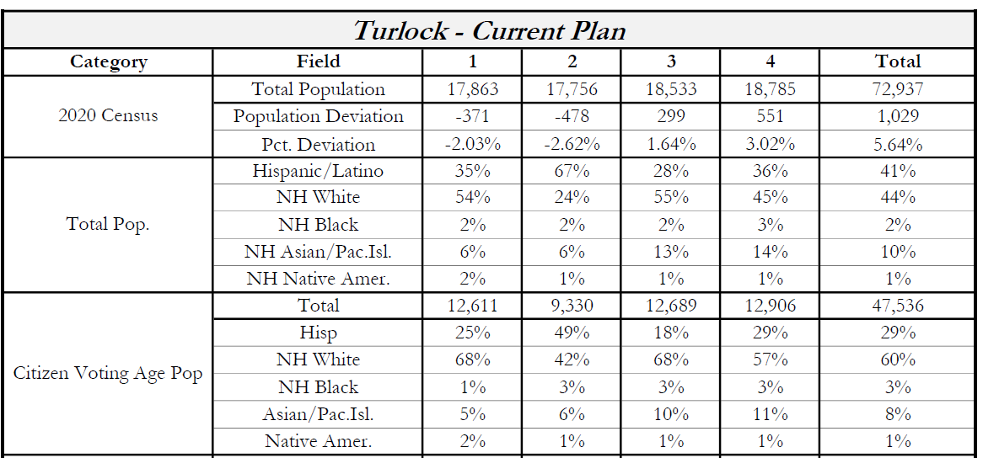
2020 Census

Slide 5

Defining Neighborhoods
1st Question: What is your neighborhood?
2nd Question: What are its geographic boundaries?
Examples of physical features defining a neighborhood boundary:
Natural neighborhood dividing lines, such as highway or major roads, rivers, canals and/or hills
Areas around parks or schools
Other neighborhood landmarks
In the absence of public testimony, planning records and other similar documents may provide definition.

Slide 6
Beyond Neighborhoods:
Defining Communities of Interest
1st Question: What defines your community?
Geographic Area, plus
Shared issue or characteristic
  Shared social or economic interest
  Impacted by city policies
Tell us “your community’s story”
2nd Question: Would this community benefit from being “included within a single district for purposes of its effective and fair representation”?
Or would it benefit more from having multiple representatives?
Definitions of Communities of Interest may not include relationships with political parties, incumbents, or political candidates.

Slide 7
Possible Neighborhoods / Communities

Slide 8
Public Mapping and Map Review Tools
Different tools for different purposes
Different tools for different levels of technical skill and interest
  Simple “review draft maps” tool
  Easy-to-use “Draw your neighborhood” tool
  Paper- and Excel-based simple “Draw a draft map” tools
  Powerful, data-rich “Draw a draft map” tool
  NEW OPTION: Submit using your own mapping software
Whether you use the powerful (but complicated) online mapping tool, Excel, the paper kit, or just draw on a napkin, we welcome your maps!

Slide 9
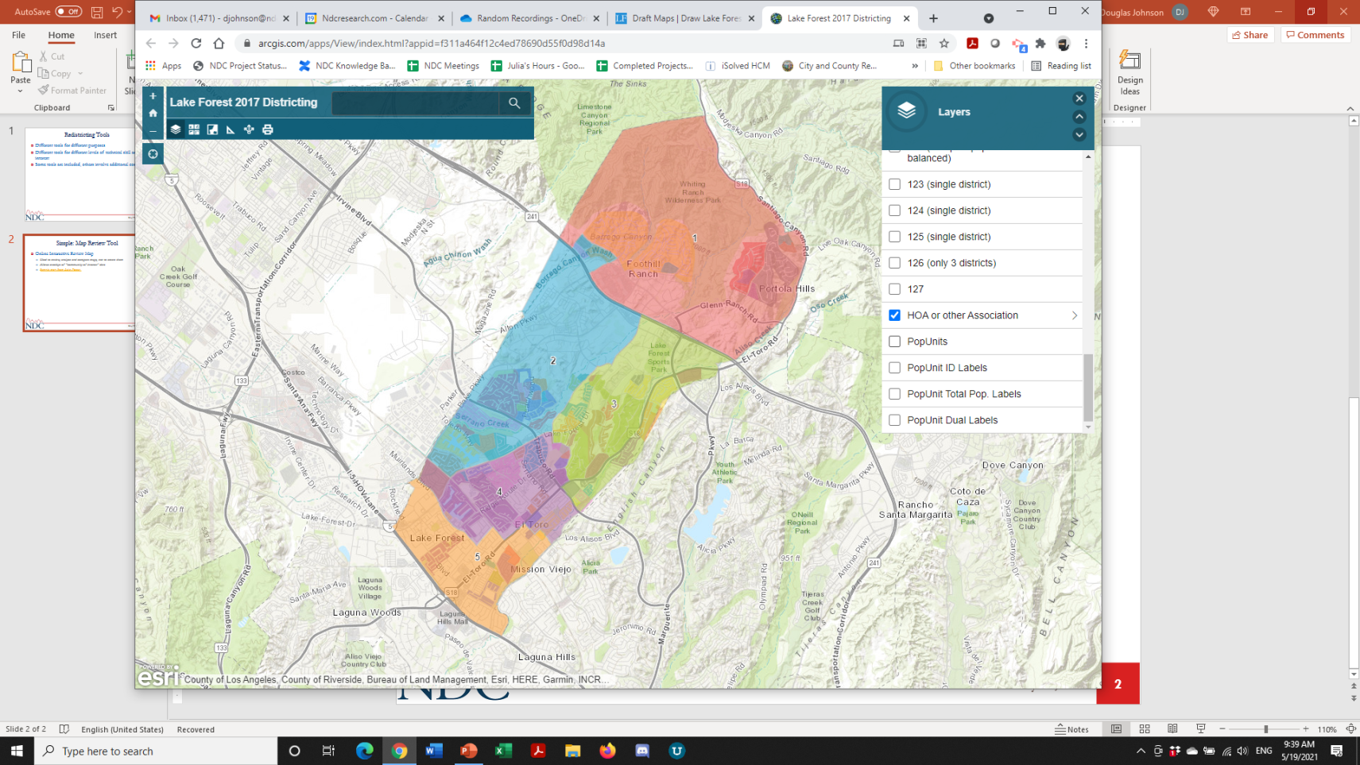
Simple Map Review Tool
Online Interactive Review Map
ESRI’s “ArcGIS Online” – similar to Google Maps in ease of use
Used to review, analyze and compare maps, not to create them
Includes overlays of “community of interest” and other data

Slide 10
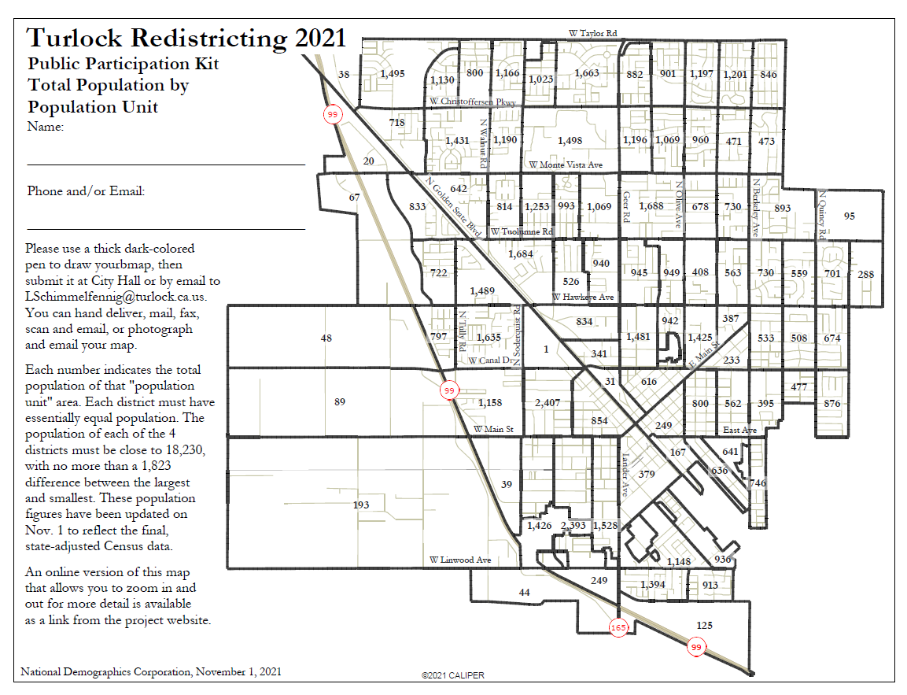
Simple Map Drawing Tool
Paper “Public Participation Kit”
For those without internet access or who prefer paper
Total Population Counts only – no demographic numbers

Slide 11
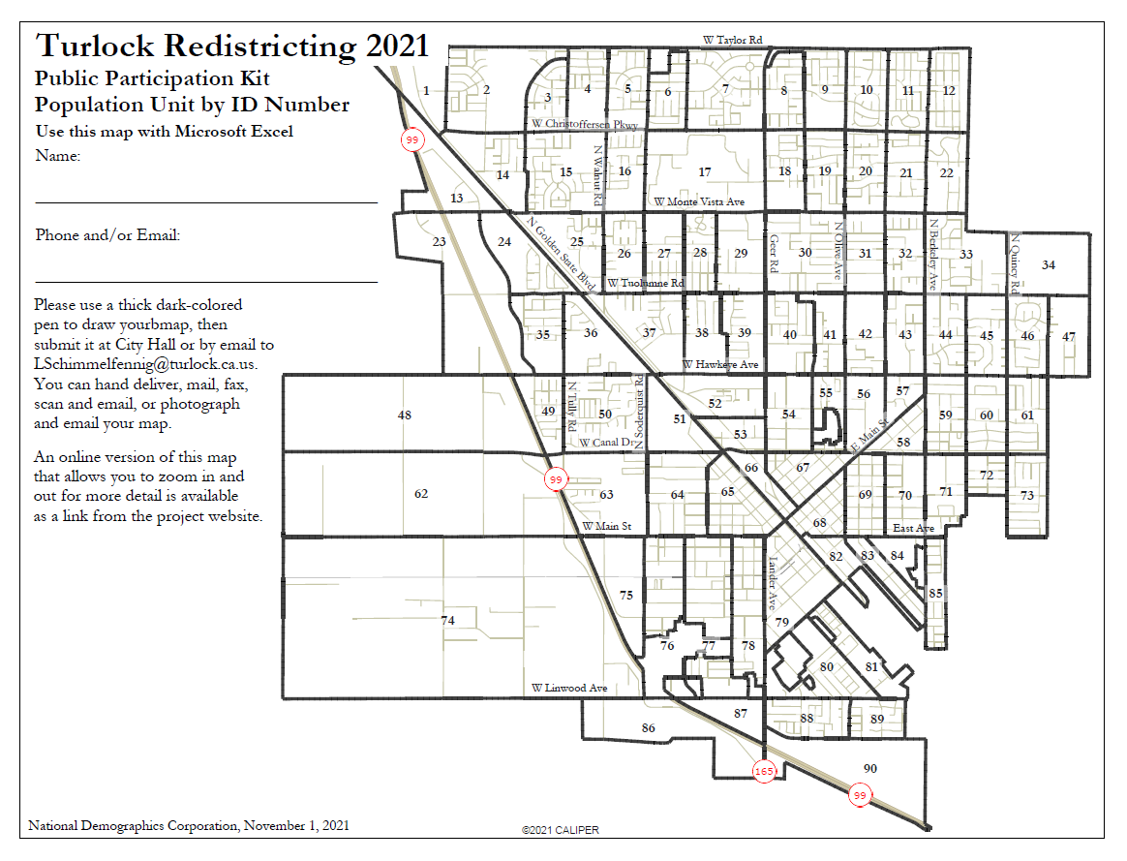
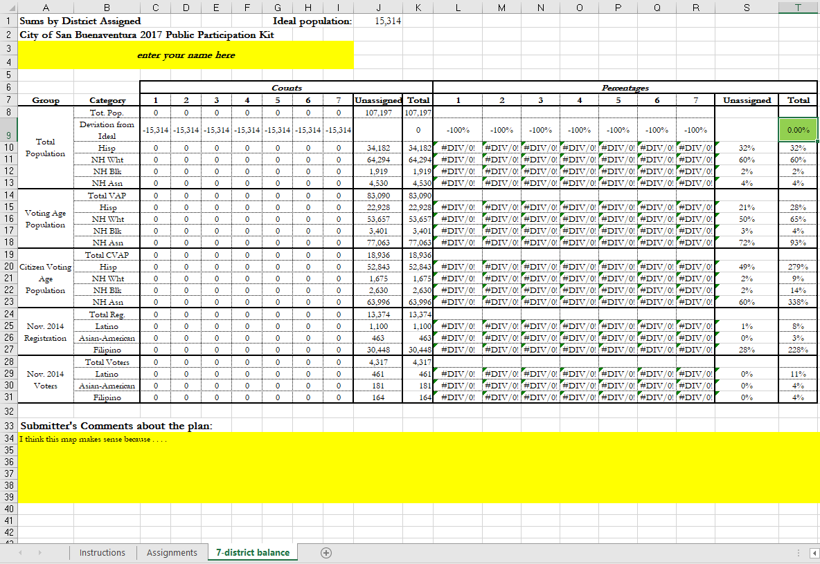
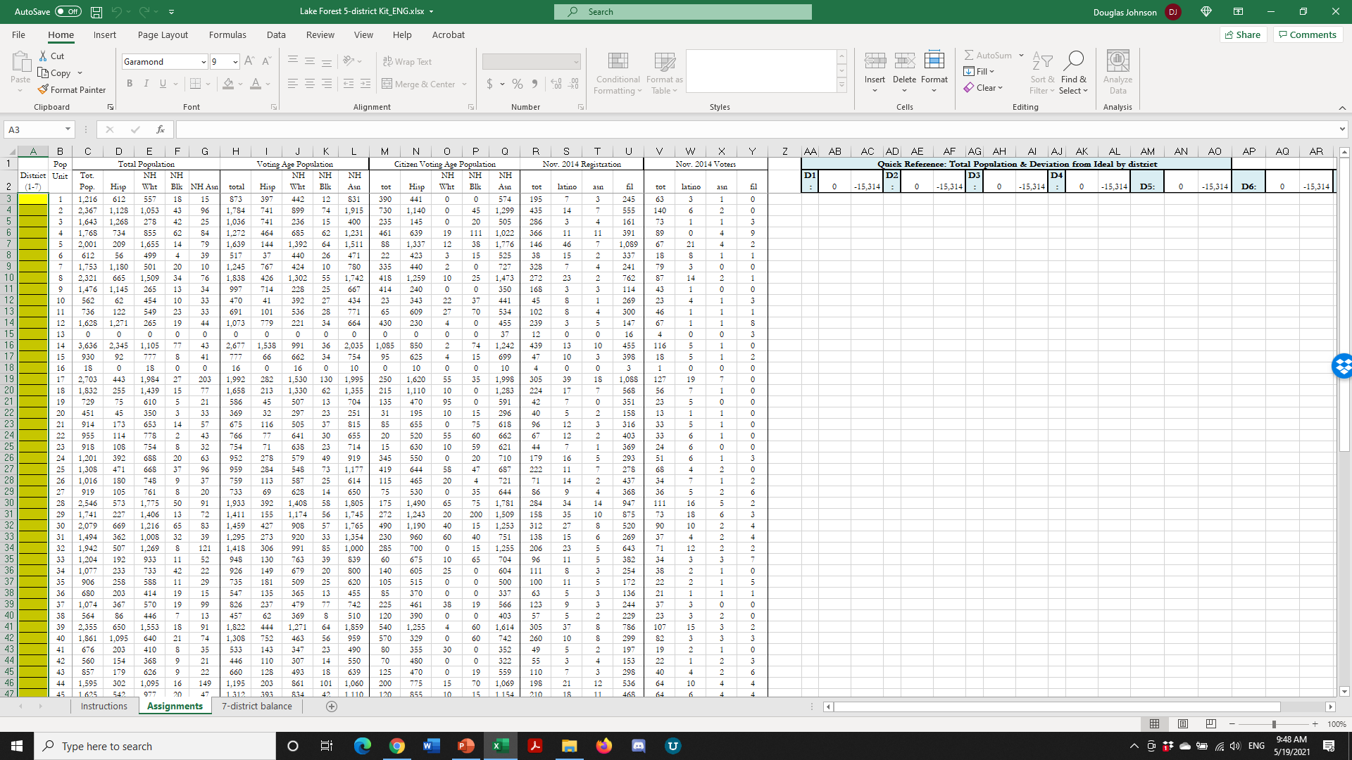
Simple Map Drawing Tool + Excel Supplement
“Public Participation Kit”
For those who know Excel and do not wish to use online tools
Adds CVAP data
Excel does the math

Slide 12
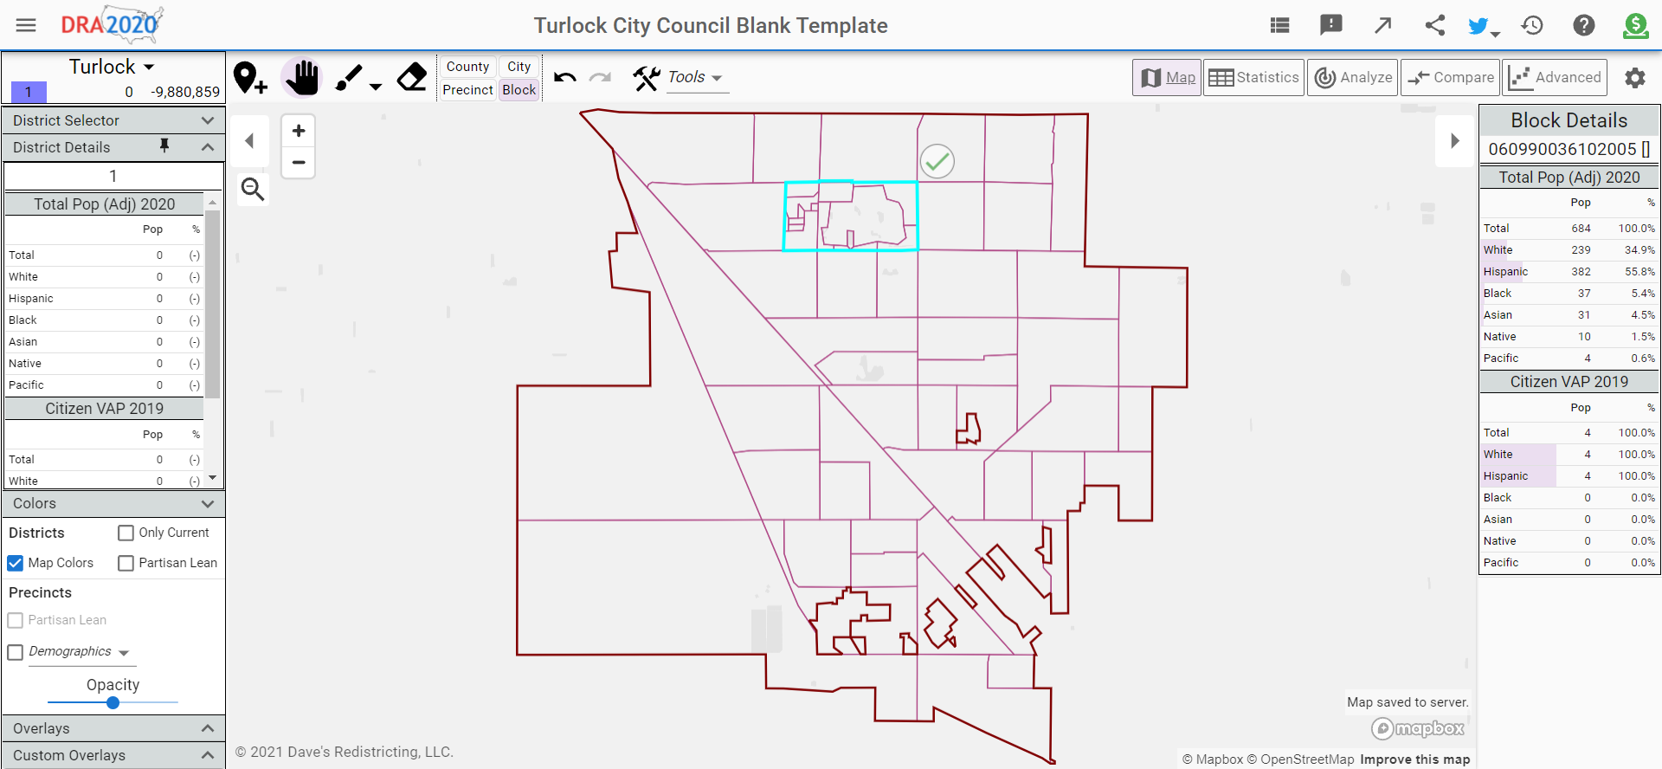
Dave’s Redistricting
“Draw Your Districts” focus
DavesRedistricting.org
November 8, 2021

Slide 13
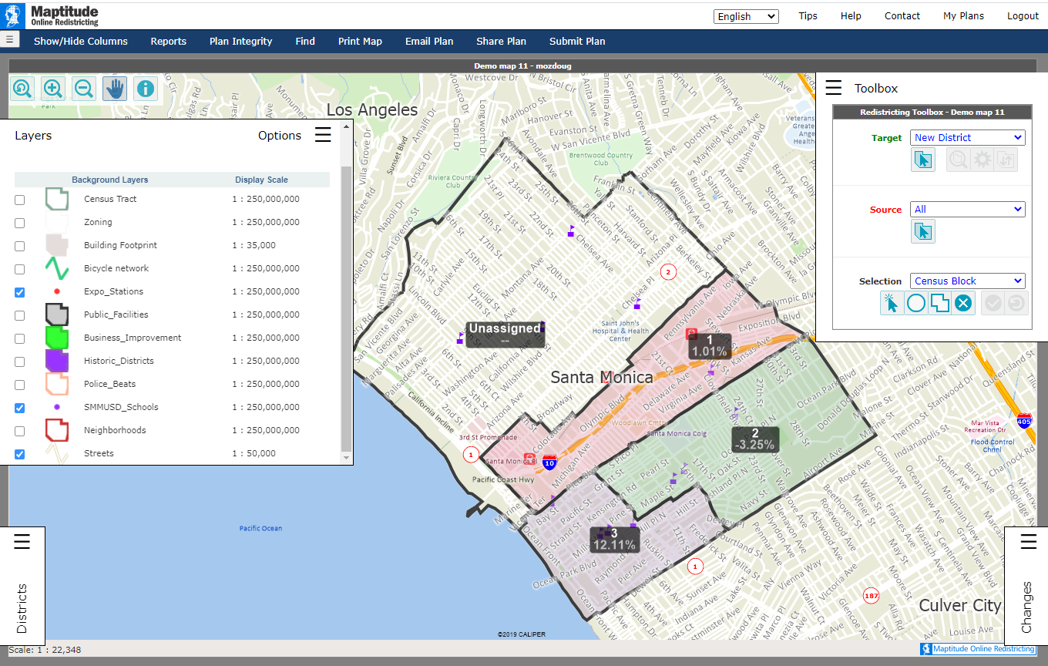
Caliper’s “Maptitude Online Redistricting”
Full Database, Powerful Online Mapping Tool
Powerful, common, data-rich online tool
Six language options: English, Spanish, Portuguese, Vietnamese, Mandarin and Korean

Slide 14
Public Hearing & Discussion
What is your neighborhood and what are its boundaries?
What other notable areas are in the City, and what are their boundaries?
Any questions about the mapping tools?
Discussion on:
    “neighborhoods”
    “communities of interest . . . that should be included within a single district for purposes of its effective and fair representation.”

Slide 15
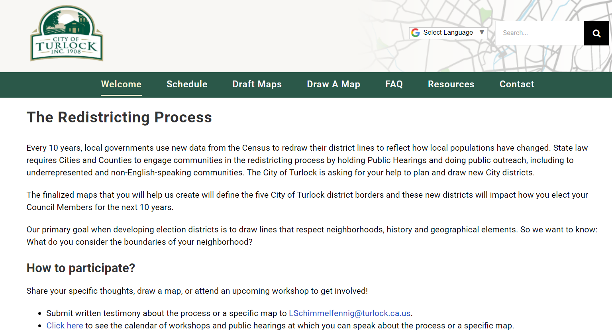
Stay Connected
RedistrictTurlock.org
LSchimmelfennig@turlock.ca.us | 209.668.5540

