Slide 1
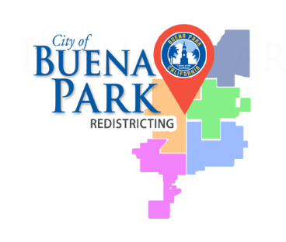
REDISTRICTING BUENA PARK
DRAFT MAPS

Slide 2
TIMELINE & PROCESS
Step
Description
Public
Hearing
#1
Held prior to release of draft maps
July 13
Education and to solicit input on the communities in the Districts
Community Workshop
Beatty Middle School
July 29
Learn about redistricting and how to develop and submit
your own map
Census Data Release
Census Bureau released official 2020 Census population data in legacy format
August 12
Public Hearing #2
Held prior to release of draft maps
August 24
Education and to solicit input on the communities in the Districts
Community Workshop
Council Chamber
September 9
Learn about redistricting and how to develop and submit your own map
California Data Release
California Statewide Database released California’s official “prisoner
September 20/27
adjusted” 2020
redistricting data, then a mandated three
-
week waiting
period before maps are released.
Community Workshop
San Marino Elementary School
October 21
Learn about redistricting and how to develop and submit your own map
Community Workshop
Raymond
Temple Elementary School
November 2
Learn about redistricting and how to develop and submit your own map
Public Hearing #3
Discuss and rev
ise
draft maps
at Buena Park Council Chamber
January 25
Solicit feedback from the public about draft maps
Public Hearing #4
Discuss and revise draft maps at Buena Park Council Chamber
March
8
Discuss,
identify
and adopt recommended final map
April 17, 2022
(Election Minus 205)
Statutory deadline to adopt map

Slide 3
REDISTRICTING RULES & GOALS
FEDERAL LAWS
CALIFORNIA CRITERIA FOR
CITIES
OTHER TRADITIONAL REDISTRICTING PRINCIPLES
Equal Population
Federal Voting Rights Act
No Racial Gerrymandering
Geographically contiguous
Undivided neighborhoods and “communities of interest”
(Socio-economic geographic areas that should be kept together)
Easily identifiable boundaries
Compact (Do not bypass one group of people to get to a more distant group of people)
PROHIBITED
SHALL NOT FAVOR OR DISCRIMINATE AGAINST A POLITICAL PARTY.
Minimize voters shifted to different election years.
Respect voters’ choices / continuity in office.
Future population growth.
Preserving the core of existing districts
National Demographics Corp.

Slide 4
DEMOGRAPHIC SUMMARY OF EXISTING DISTRICTS
Table shows official California-adjusted 2020 demographic data
Each of the five districts must contain about 16,838 people

Slide 5
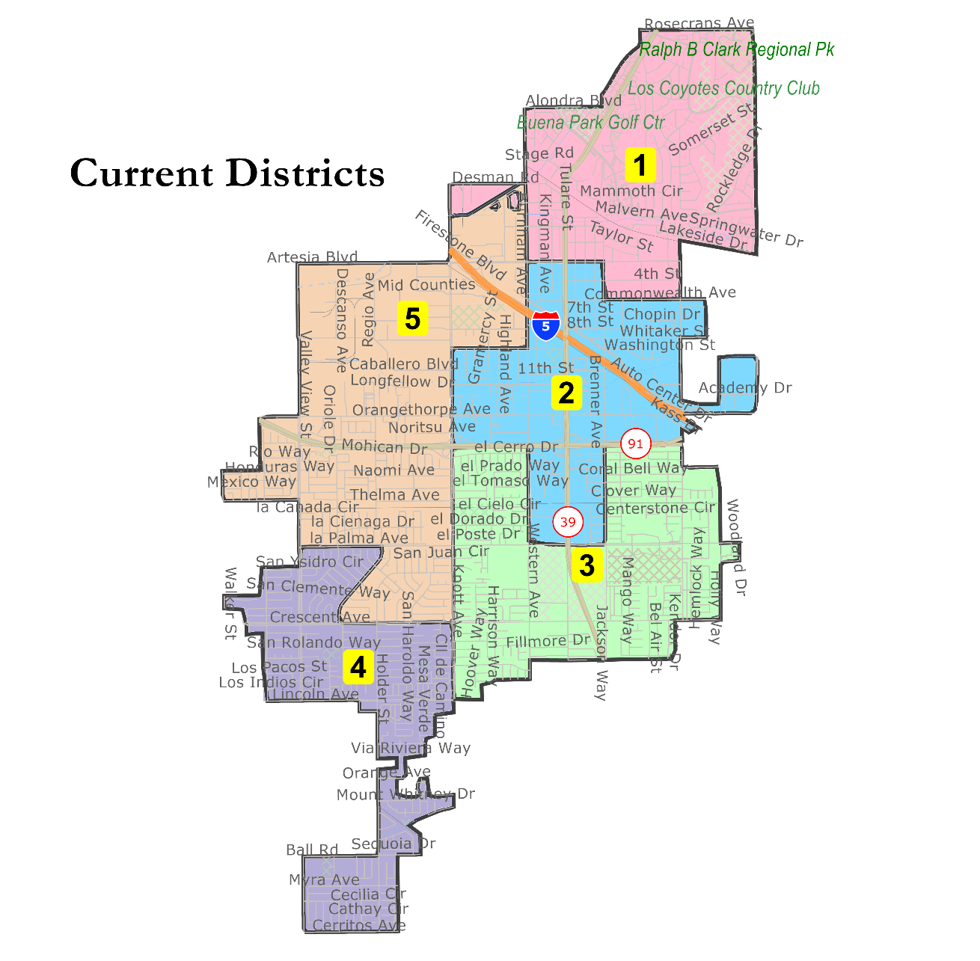
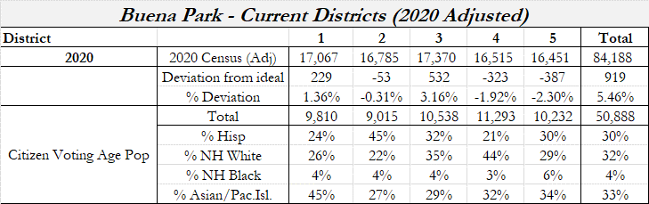
Population Balanced at 5.46%
District 2 is 45% Latino Citizen Voting Age Population, which does not achieve a majority Latino CVAP achieved in other maps.
District 1 is non-contiguous at Kensington Drive due to the Census Bureau reconfiguring the census block geography.
While balanced, the existing districts map should not be adopted due to the low Latino CVAP and the non-contiguous D1.

Slide 6
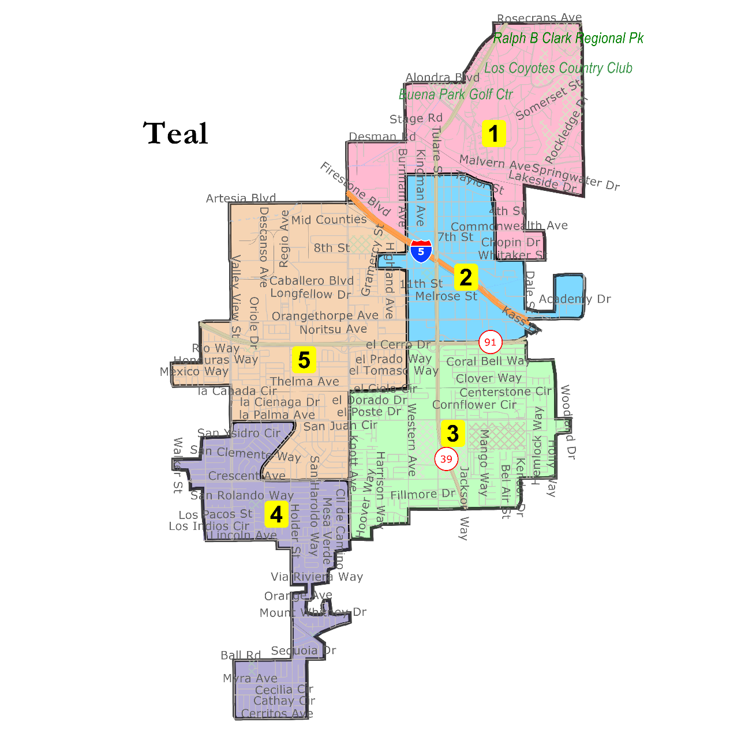
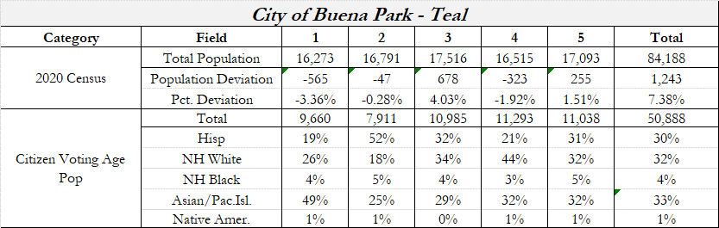
Population Balanced at 7.38%
District 2 is 52% Latino Citizen Voting Age Population.
District 2 does not extend below the 91 freeway.
Districts 1 and 2 follow the same geography as the Buena Park Library's newly-adopted Green Map.
District 1 extends southerly to Whitaker Street.
The District 2 jog between 8th and 9th street along Western is necessary for population balance.

Slide 7
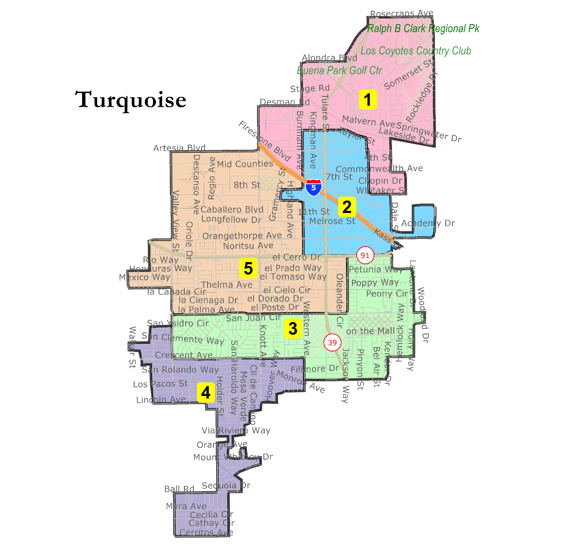
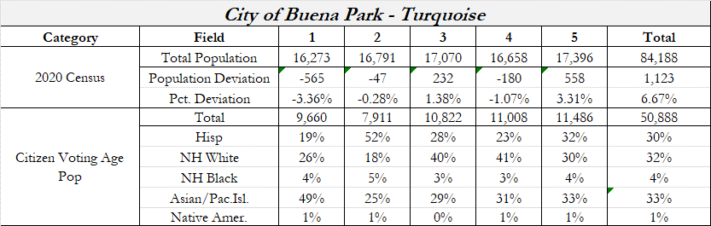
Population Balanced at 6.67%
District 2 is 52% Latino Citizen Voting Age Population.
Keeps the same D1 and D2 boundaries as Teal.
Keeps the "El" Tract together in D5.
Keeps the "San" Tract between La Palma Avenue and Crescent Avenue together.

Slide 8

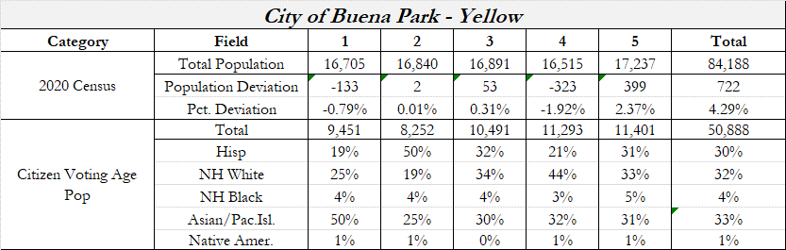
Population Balanced at 4.29%
District 2 is 50%+ Latino Citizen Voting Age Population.
District 2 does not extend below the 91 freeway.
District 1 extends southerly to Commonwealth.
The District 2 jog between 9th street and Melrose Street along Western is necessary for population balance.

Slide 9
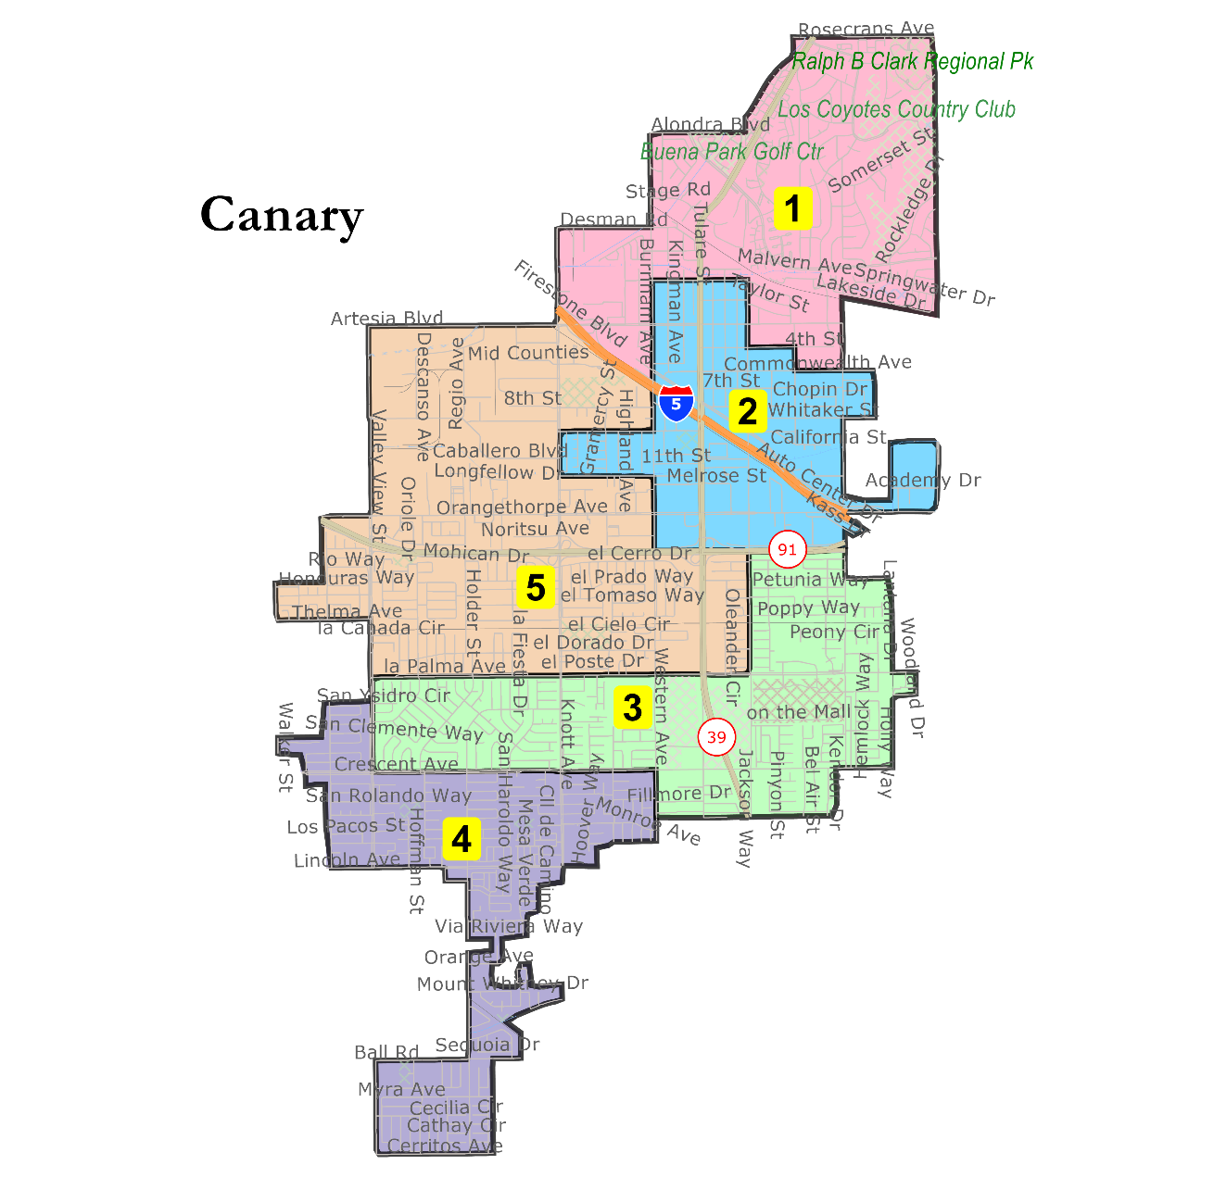
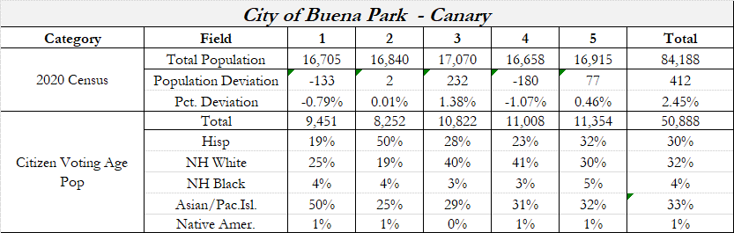
Population Balanced at 2.45%
District 2 is 50%+ Latino Citizen Voting Age Population.
Keeps the same D1 and D2 boundaries as Yellow.
Keeps the "El" Tract together in D5.
Keeps the "San" Tract between La Palma Avenue and Crescent Avenue together.

Slide 10





Slide 11
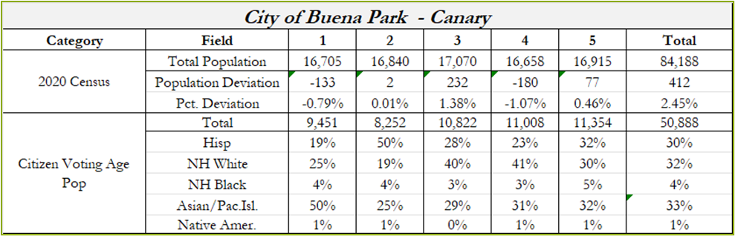

Slide 12
Election Year 2022: Districts 1, 2, 5
Election Year 2024: Districts 3, 4
After focus maps are identified, it is recommended the City Council review and, if needed, adjust the district number assignments.

Slide 13
Public hearing to receive input on draft maps.
Goal to identify 1-2 focus maps.
Review and adjust the district assignments on the focus maps, if needed.
Council can request variations be drawn on the focus map(s).
All the maps and the full demographic summaries can be viewed on the website at redisrictbp.org.
The best way to view the maps in detail is through the interactive map viewer at this link: https://arcg.is/19bHiu

Slide 14
WWW.REDISTRICTBP.ORG

