Slide 1
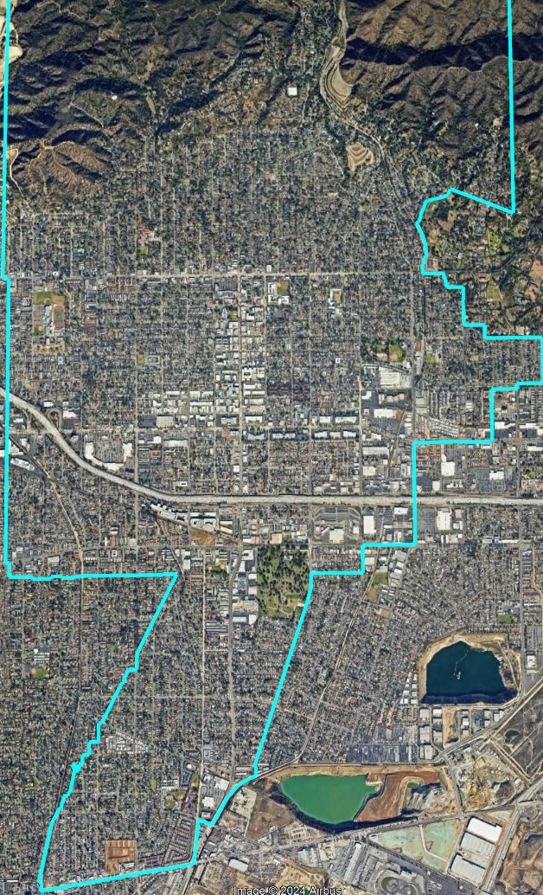
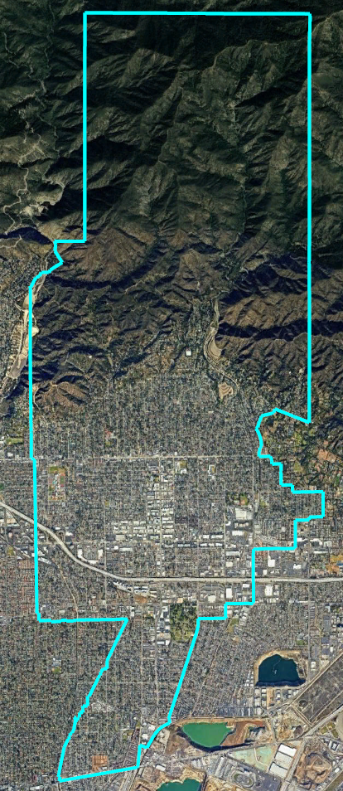
Monrovia Unified School District
Board Hearing

Slide 2
Districting Process
Step | Description
Two Initial Hearings April 17 & 29 | Held prior to release of draft maps. Education and to solicit input on the composition of districts.
Community Forum April 22 – 6 PM | Public Education / Opportunity for feedback Monrovia High School
Release draft maps | Maps must be posted at least 7 days prior to 3rd hearing.
Community Forum May 13 – 6 PM | Public Education / Opportunity for feedback Zoom
Two hearings on draft maps May 15 & 22 | Two meetings to discuss and revise the draft maps and to discuss the election sequence.
Community Forum May 20 – 6 PM | Public Education / Opportunity for feedback Monrovia High School
Map Selection May 22 or 28 | Map selected and a County Committee petition filed via resolution. Final map must be posted at least 7 days prior to adoption.
County Committee Hearing and Vote | County Committee on School District Organization holds a hearing and holds a final vote on the District’s transition and map.

Slide 3
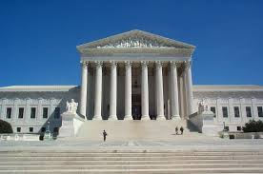
Districting Rules and Goals
1. Federal Laws
2. California Criteria
2. California Prohibition
Equal Population
Federal Voting Rights Act
No Racial Gerrymandering
In prioritized order:
Geographically contiguous
Avoid division of neighborhoods and “communities of interest”
(Socio-economic geographic areas that should be kept together)
Avoid division of Cities and Census Designated Places
Easily identifiable boundaries
Compact
(Do not bypass one group of people to get to a more distant group of people)
“Shall not adopt election district boundaries for the purpose of favoring or discriminating against an incumbent, political candidate, or political party.”
3. Other Traditional Redistricting Principles
Future population growth

Slide 4
Demographic Summary
Each of the five trustee areas must contain about 8,894 people.

Slide 5
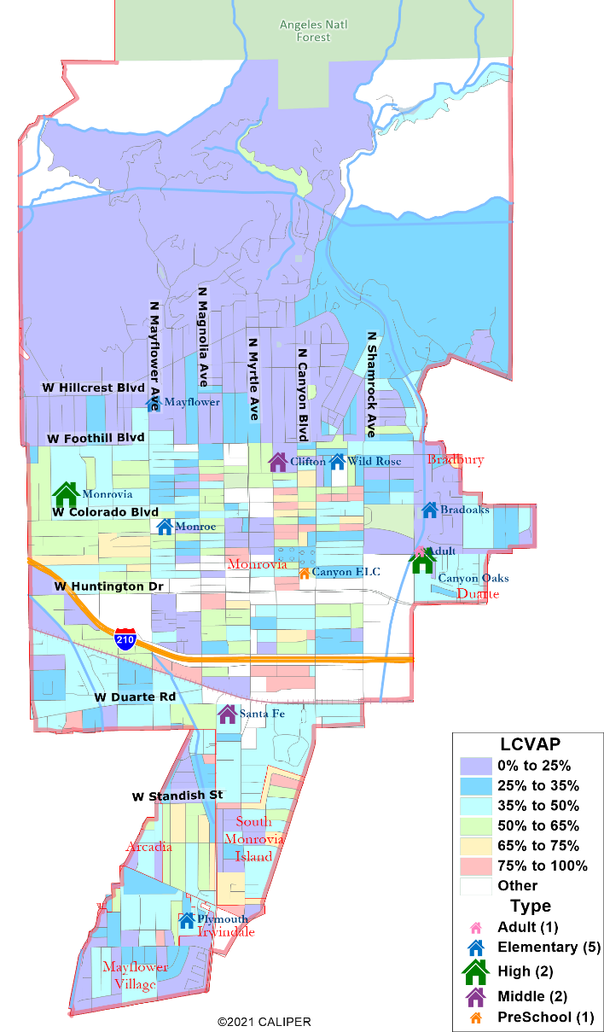
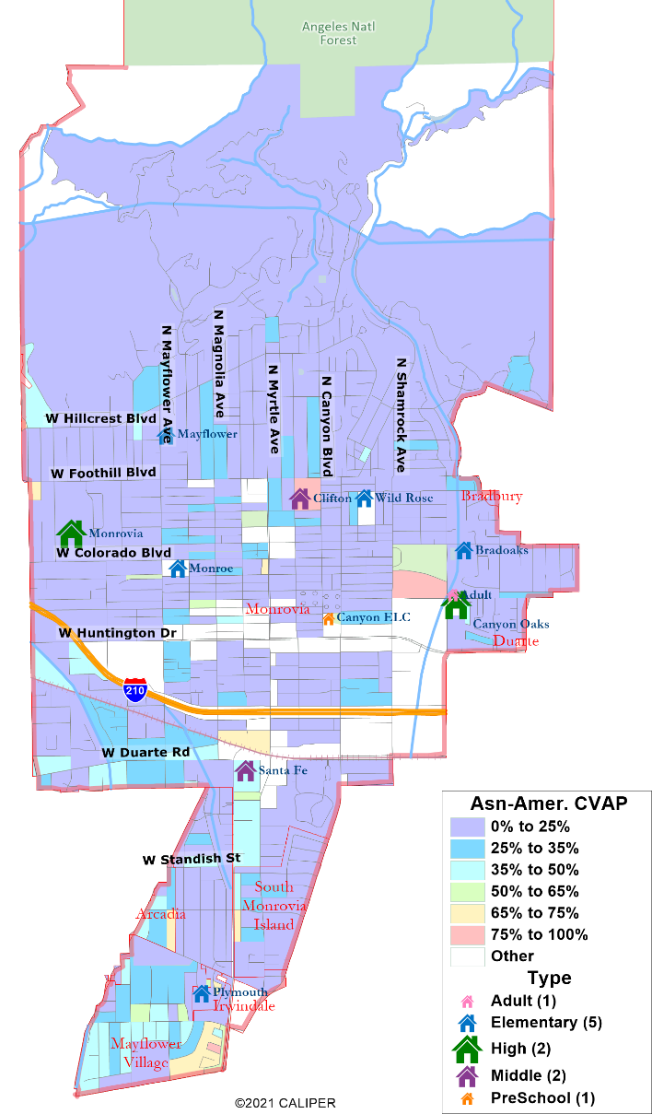
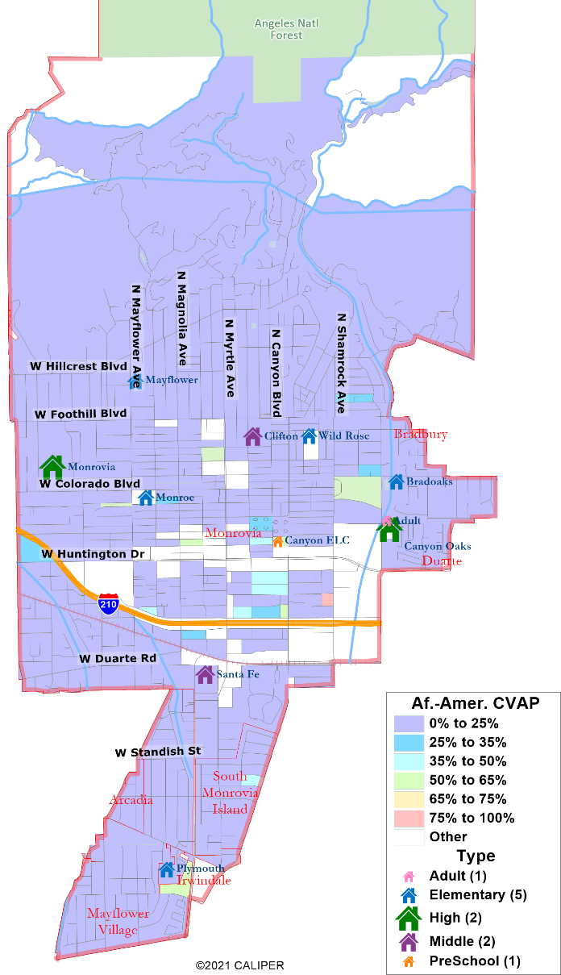
Protected Class CVAP

Slide 6
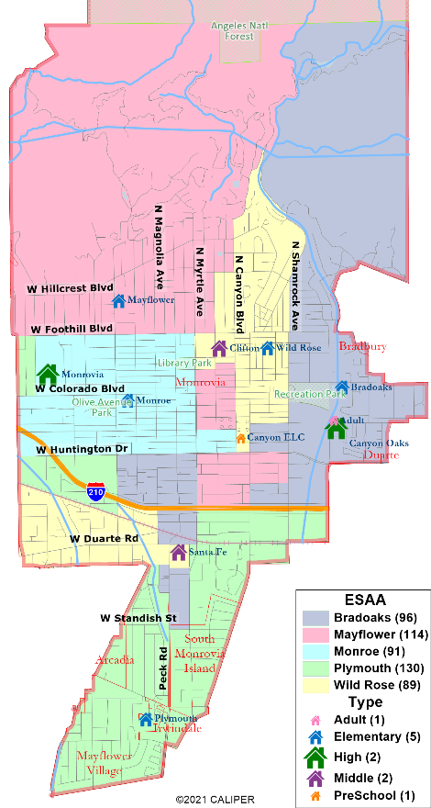
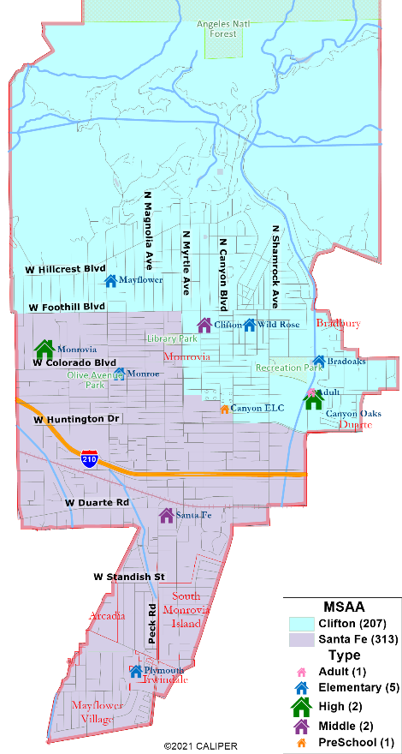
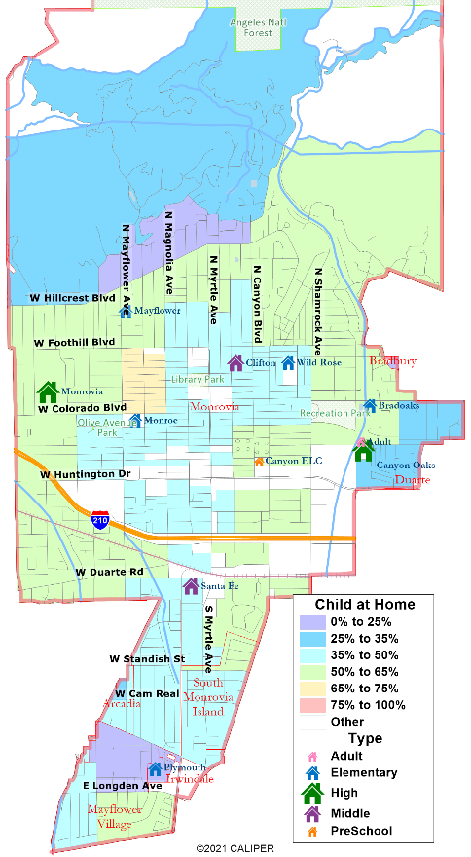
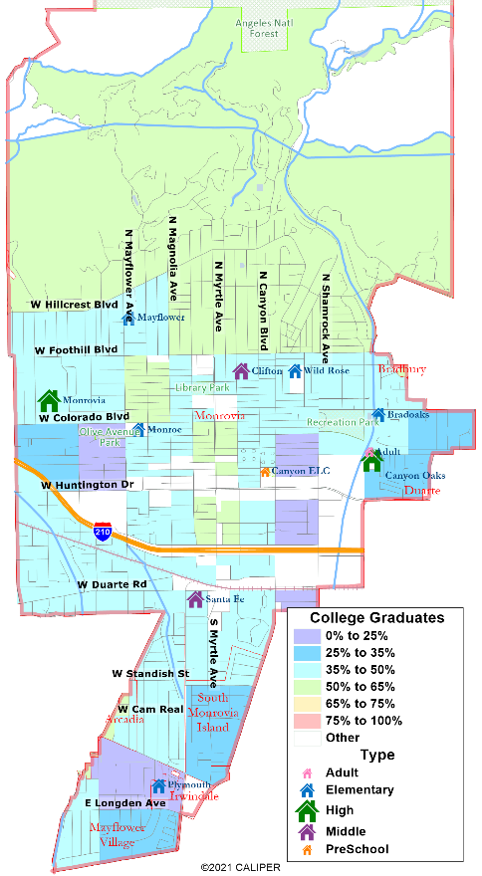
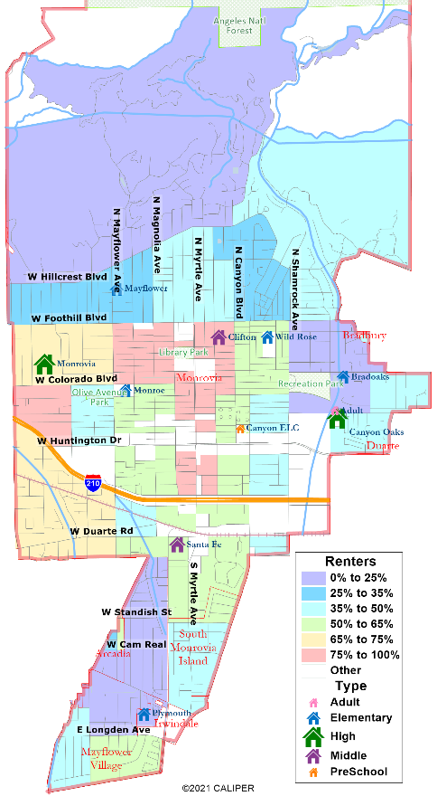
Other Maps & Demographics

Slide 7
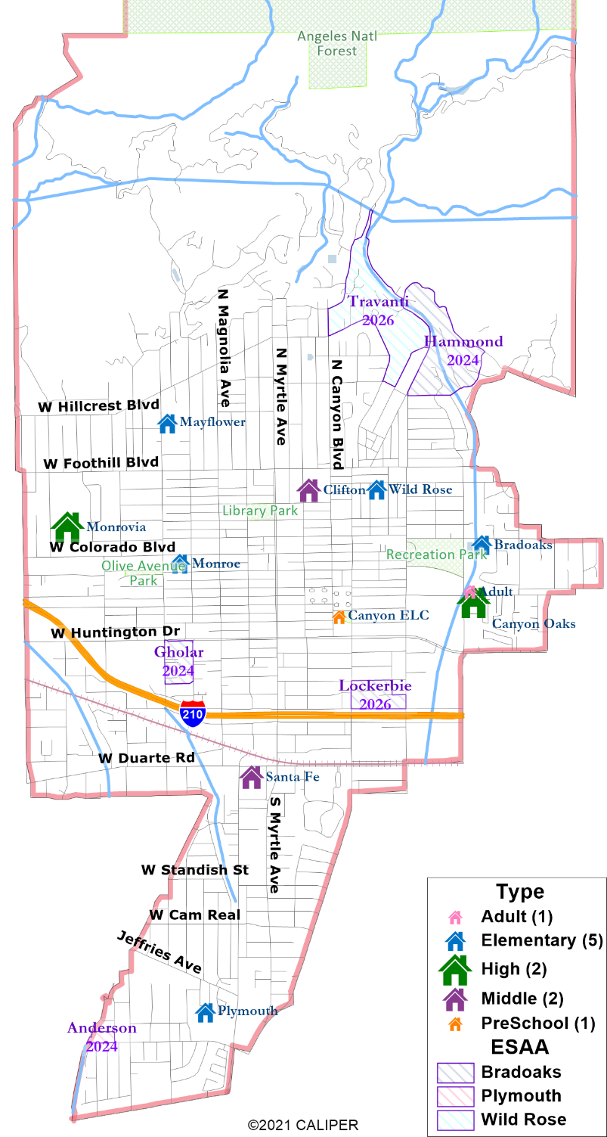
Schools & Trustees
“Shall not adopt election district boundaries for the purpose of favoring or discriminating against an incumbent, political candidate, or political party.”

Slide 8
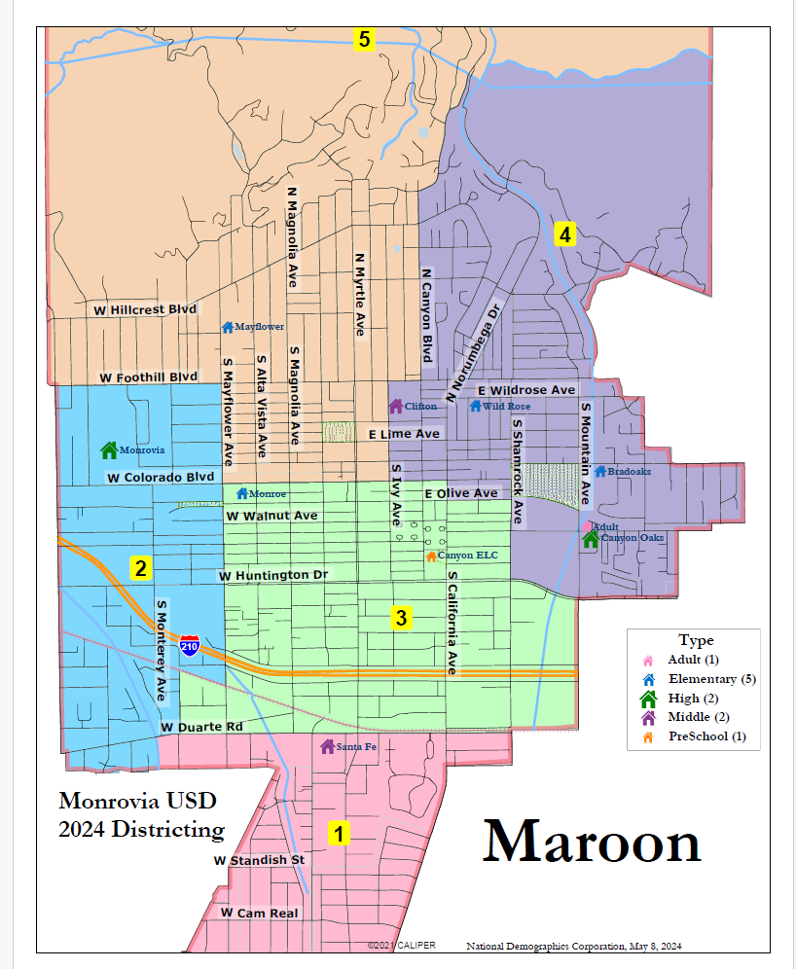
Draft Maps: Maroon
Total Deviation: %6.27

Slide 9
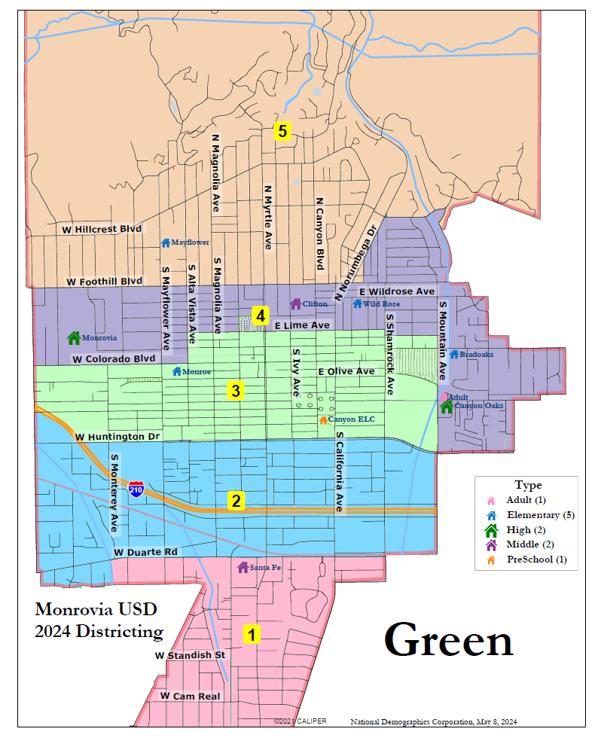
Draft Maps: Green
Total Deviation: %5.85

Slide 10
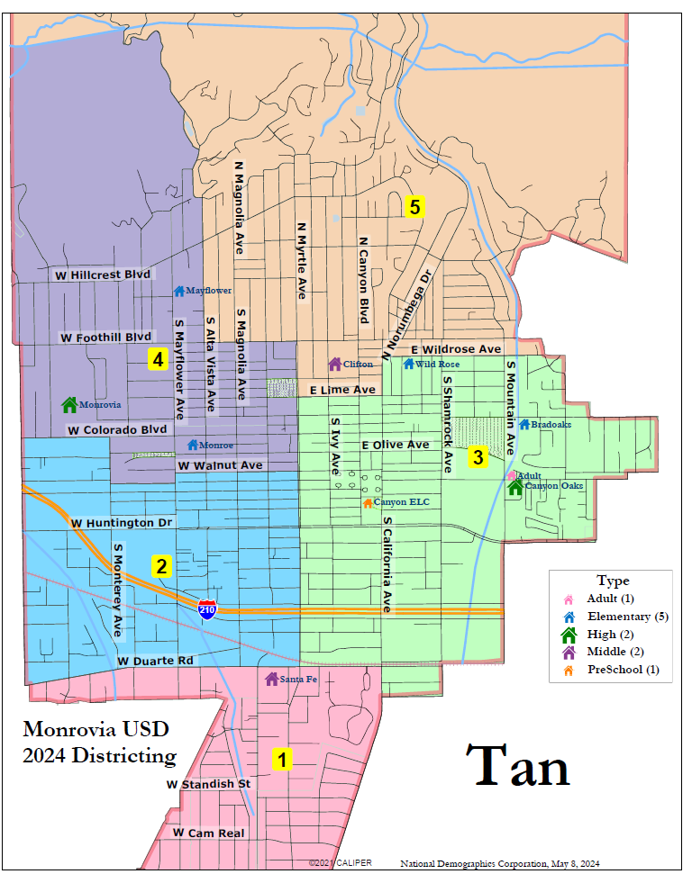
Draft Maps: Tan
Total Deviation: %4.41

Slide 11
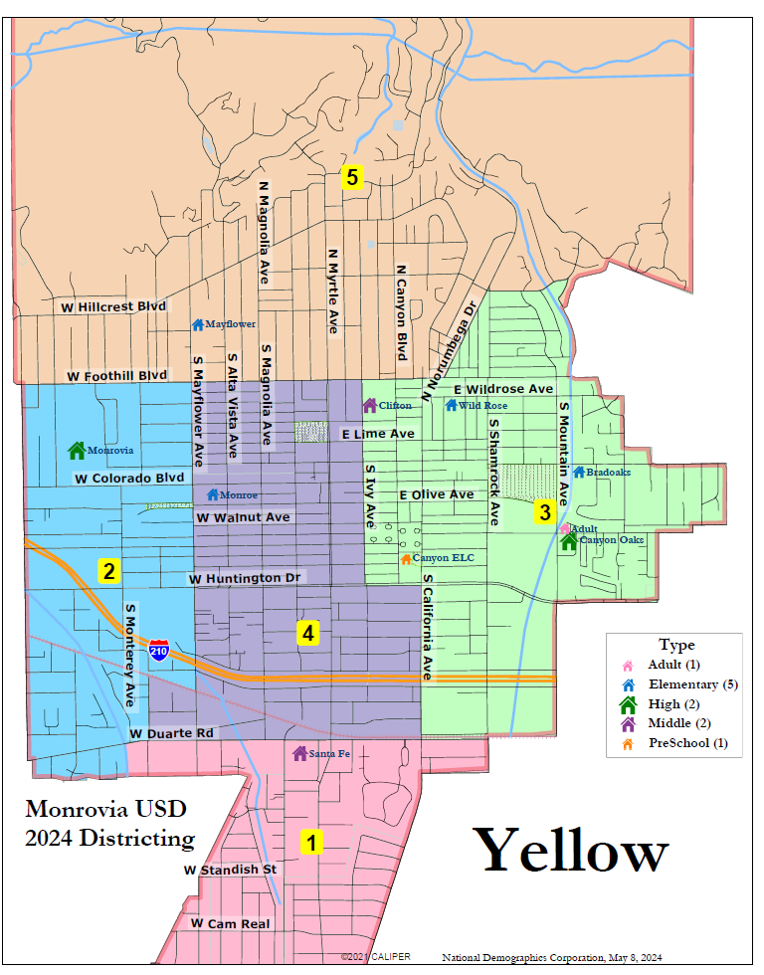
Draft Maps: Yellow
Total Deviation: %5.25

Slide 12





Your Turn:
What area do you consider your neighborhood?
What are your “communities of interest”?
    For each answer, please provide:
    Geographic boundaries
    The history or defining shared characteristic of the area
    In the absence of public testimony, planning records and other similar documents may provide definition.
Any other questions about the process, criteria, maps, or any other part of this process?

