Slide 1
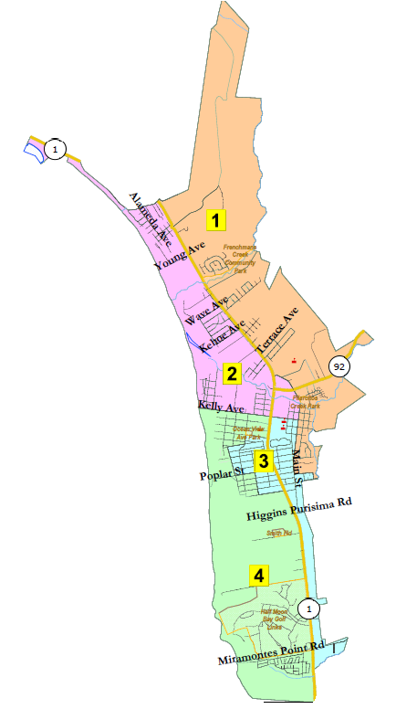
City of Half Moon Bay
Redistricting Map Adoption
Redistricting Advisory Committee
Marin Holt, Chair
Paul Gater, Vice Chair
Hal Bogner, Committee Member
Steve Maller, Committee Member
Claudia Marshall, Committee Member
Phil Marshall, Committee Member
Michal Settles, Committee Member
National Demographics Corporation

Slide 2
Step | Description
Workshops (RAC) Aug. 12 & Aug. 19 | Education and to solicit input on the communities in the Districts.
Two Pre-Map Hearings (RAC) Aug. 26 & Sept. 2 | Held prior to release of draft maps. Education and to solicit input on the communities in the Districts.
Census Data Release Aug. 12 | Census Bureau releases official 2020 Census population data. The data will be in legacy format and must be reformatted.
California Data Release Sept. 20 | California Statewide Database releases ‘prisoner-adjusted’ 2020 redistricting data, then three-week waiting period to release maps.
Review Draft Maps (RAC) Nov. 8 | Review and revise the draft maps and to select focus maps.
Map Submission Deadline Nov. 26, 5 p.m. | The City’s demographer will professionally produce submitted maps and prepare a demographic summary for each map.
Review Draft Maps (RAC) Dec. 16 | Review and revise the draft maps and to select focus maps.
Post-Map Hearing (CC) Jan. 19 | First public hearing to discuss and revise the draft maps and to discuss the election sequence.
Workshop (RAC) Jan. 27 | Solicit input on focus maps. Any proposed revisions to focus map must be received by Feb. 4.
Post-Map Hearing (CC) Feb. 15 | Second public to review proposed map(s) and introduce an ordinance to adopt a map.
Map Adoption (CC) Mar. 15 | Final map must be posted at least 7 days prior to adoption. Map adopted via ordinance. Deadline to adopt: Apr. 17, 2021

Slide 3
Communities of Interest
Latino/Hispanic neighborhoods Under-represented communities Canada Cove with other senior housing. Frenchman’s Creek with northern district. Oak Park undivided. Alsace Lorraine with Ocean Colony Arleta Park Household Income Renters v. Owners; Housing Types Downtown Senior Communities Traffic Issues

Slide 4
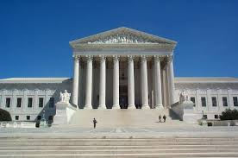
Redistricting Rules and Goals
1. Federal Laws
2. California Criteria for
Cities
3. Other Traditional Redistricting Principles
Equal Population
Federal Voting Rights Act
No Racial Gerrymandering
Geographically contiguous
Undivided neighborhoods and “communities of interest”
(Socio-economic geographic areas that should be kept together)
Easily identifiable boundaries
Compact
(Do not bypass one group of people to get to a more distant group of people)
Prohibited: “Shall not favor or discriminate against a political party.”
Minimize voters shifted to different election years
Respect voters’ choices / continuity in office
Future population growth
Preserving the core of existing districts

Slide 5
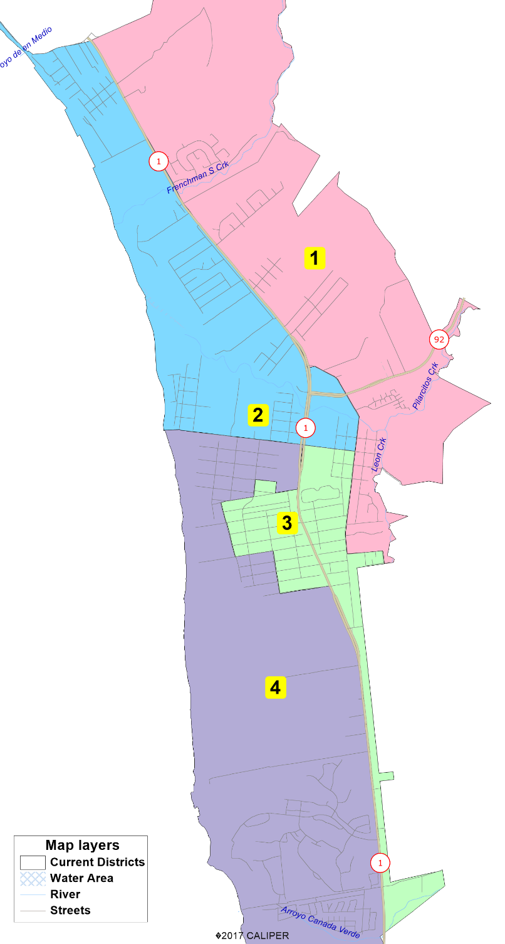
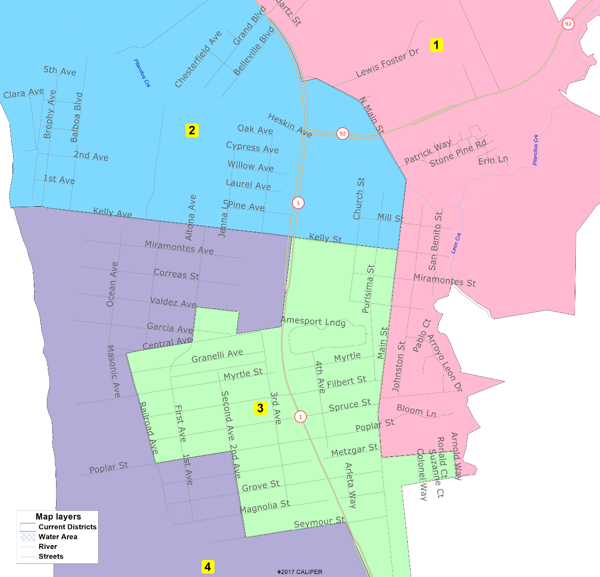
Current Districts

Slide 6
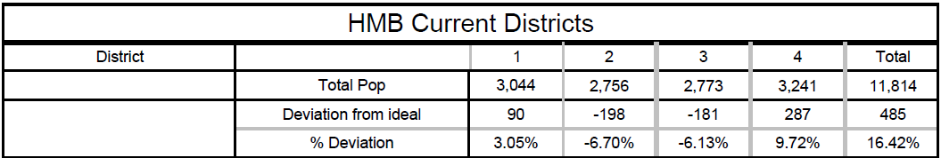
Demographic Summary of Existing Districts
Official California-Adjusted 2021 Redistricting Data
Only required change is about 200 people out of District 4 into Districts 2 and 3.

Slide 7
Preferred Map
Preferred Map Identified on 1-19-2022:
Map 504c (full version or detail, demographics)
Focus Maps Identified on 12-16-2021 (in ranked order):
5-District Plans
Map 504c (full version or detail, demographics)
Map 503b (full version or detail, demographics)
4-District Plans
Map 402 (full version or detail, demographics)
Map 403b (full version or detail, demographics)
The most detailed way to view maps is with the interactive map viewer at: https://arcg.is/1STi8P0

Slide 8
Map Summary
5-District Plan Ideal Pop: 2,363 | # of Ds | Pop Dev | Max Latino CVAP | Max Non-White CVAP | Pop Bal | Pop Deferred to 2024 | Voters Deferred to 2024 | Contig | Pairings
Preferred Map 504c | 5 | 7.32% | 26.54% | 35.47% | Yes | 1,351 | 993 | Yes | 0
Focus Map 503b | 5 | 7.36% | 27.62% | 36.60% | Yes | 843 | 695 | Yes | 0
4-District Plan Ideal Pop: 2,954 | # of Ds | Pop Dev | Max Latino CVAP | Max Non-White CVAP | Pop Bal | Pop Deferred to 2024 | Voters Deferred to 2024 | Contig | Pairings
Focus Map 402 | 4 | 3.52% | 23.63% | 32.47% | Yes | 1,493 | 1,229 | Yes | 1
Focus Map 403b | 4 | 6.47% | 23.63% | 32.47% | Yes | 1,498 | 1,202 | Yes | 1
Note: Canada Cove total population 580; registered voters 451.

Slide 9
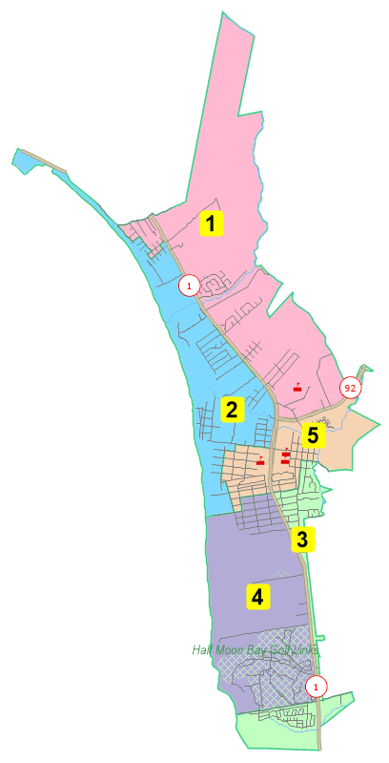
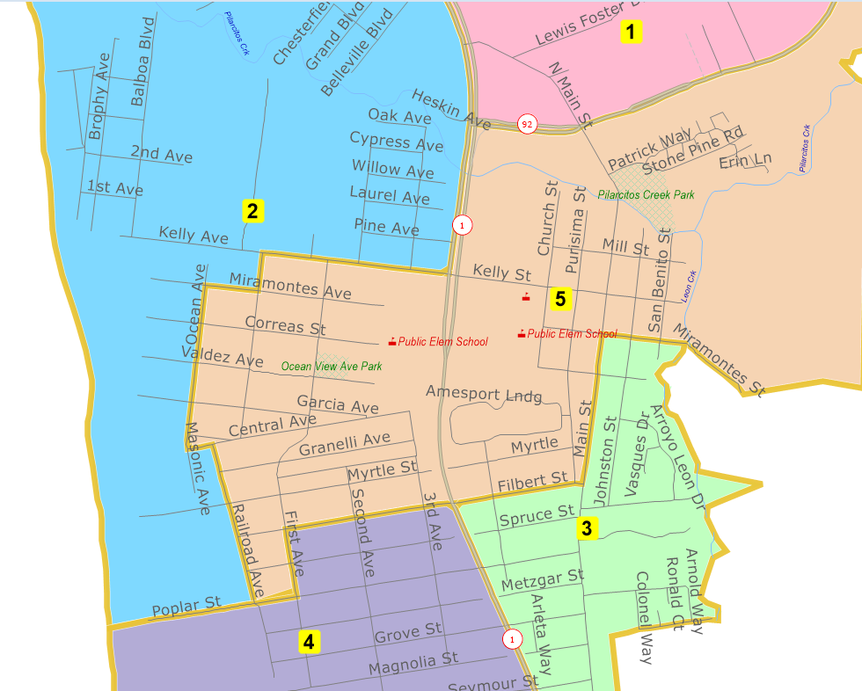
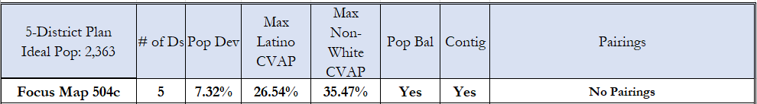
Preferred Map 504c

Slide 10
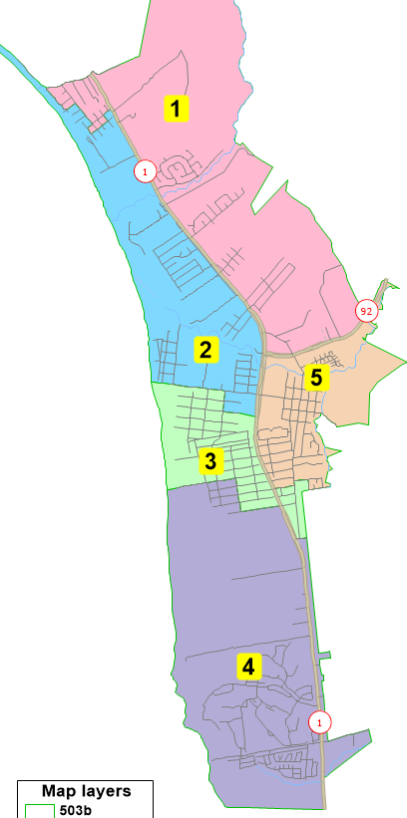
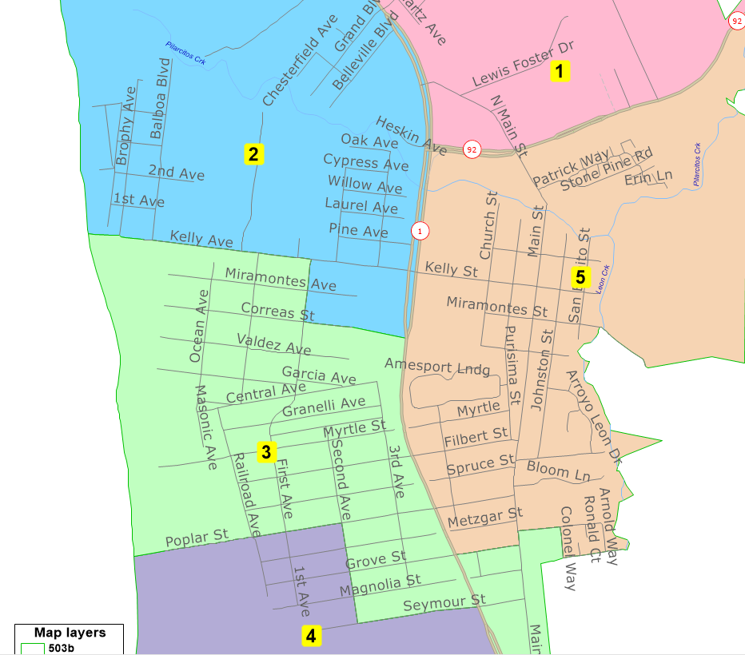
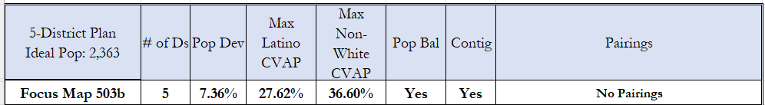
Map 503b

Slide 11
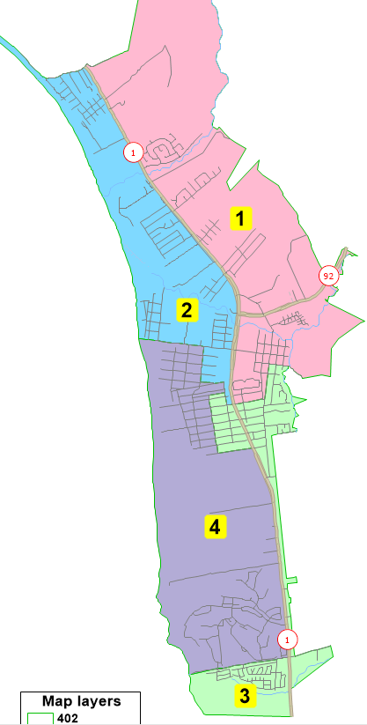
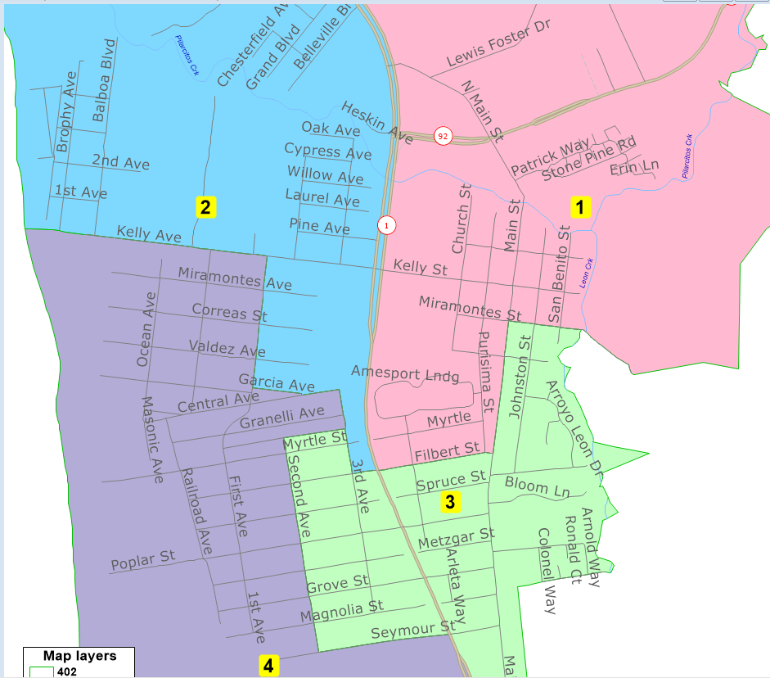
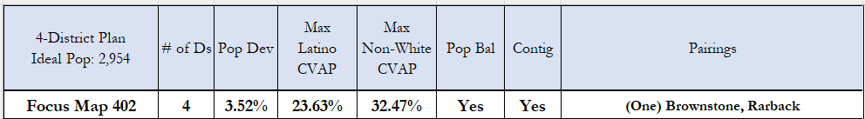
Map 402

Slide 12
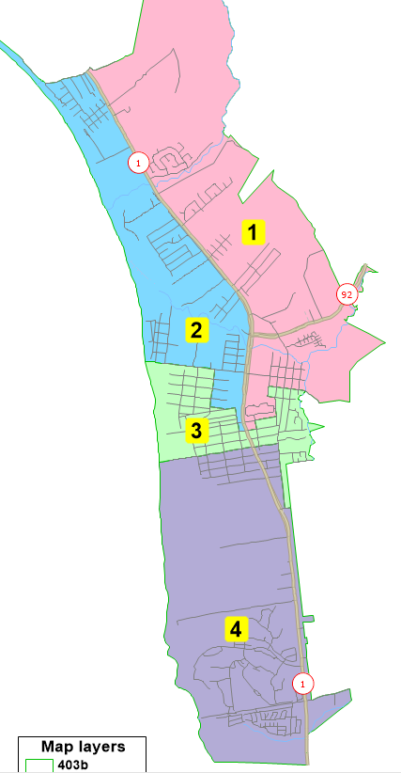
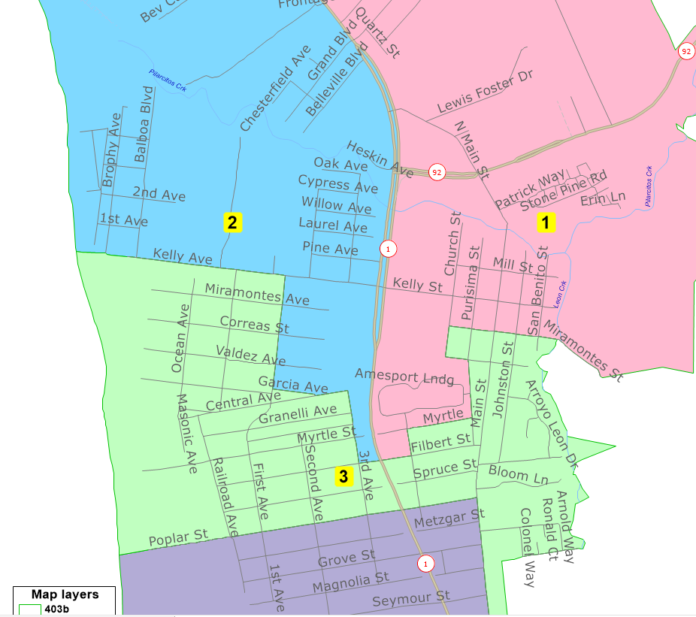
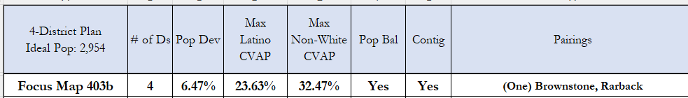
Map 403b

Slide 14
Proposed Sequencing
Election Year 2022: Districts 1, 4 (and 5 if 5-districts)
Election Year 2024: Districts 2, 3
After focus maps are identified, it is recommended the City Council and Committee review and, if needed, adjust the district number assignments.

Slide 15
Recommended Action
Hold a public hearing to receive input on the proposed council boundaries.
Identify a map for adoption and confirm the district number assignments with the election year 2022 for Districts 1, 4, and 5 (if applicable) and election year 2024 for Districts 2 and 3.
If a four-district map is selected, determine if the directly-elected Mayor shall be elected for a two-year term or a four-year term.
Vote on introduction of an ordinance to adopt the final council boundary map.

Slide 16

DrawHMB.org

