Slide 1
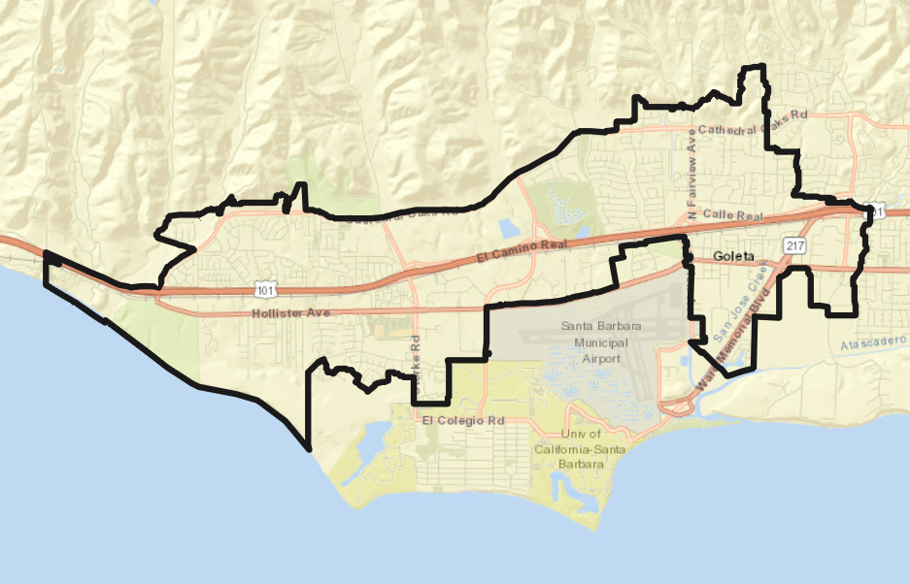
City of Goleta Update on the Districting Process

Slide 2
January 26 Meeting – What to Expect
January 6, 2022: Deadline for map submissions
January 24, 2022: Final set of draft maps posted to DrawGoleta.org with demographic analysis
January 26, 2022: PEC Meeting
Discussion of maps: NDC will provide context for general themes seen in the maps and how well each map addresses:
Legal requirements and traditional redistricting principles
Neighborhoods and communities of interest
PEC will make recommendation to Council, which may include:
General principles for map selection, e.g., “We recommend you keep X area with Y area”
Specific recommended map(s) with context for recommendation, e.g., “We recommend you choose map A, B, or C and here is why…”
Maps that should not be considered, and why

Slide 3
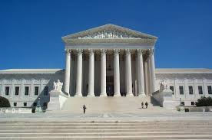
Districting Rules and Goals
1. Federal Laws
2. California Criteria for Cities
3. Other Traditional Districting Principles
Equal Population
Federal Voting Rights Act
No Racial Gerrymandering
Geographically contiguous
Undivided neighborhoods and “communities of interest” (Socio-economic geographic areas that should be kept together)
Easily identifiable boundaries
Compact (Do not bypass one group of people to get to a more distant group of people)
Prohibited:
“Shall not favor or discriminate against a political party.”
Respect voters’ choices / continuity in office
Future population growth

Slide 4
Demographic Summary
Each of the 4 districts must contain about 8,190 people.
Check out the Story Map for maps of some of this demographic data.

Slide 5
Communities of Interest & Neighborhoods Identified by the City Council
The City Council has recognized a list of communities of interest and neighborhoods to respect
This establishes a record of important areas that should be kept undivided in the map-drawing process, to the extent practicable
Not necessarily an exhaustive list, but intended as a starting point
Communities of interest are included in Attachment 1 of the Staff Report

Slide 6
Preliminary Emerging Themes
While the district drawing process is still ongoing, NDC has identified some themes in the maps that have been submitted
Only the maps drawn using the official population data are considered with these themes
The themes consider the degree to which the districts cross Highway 101
Theme 1: Minimal Crossing (67502, 77433)
Theme 2: Moderate Crossing (75901, 76245)
Theme 3: Significant Crossing (76182, 79269, 80243)
Theme 4: Not Contiguous (74226)

Slide 7
What Can You Do Now?
Once the maps are submitted, the process will move very quickly to meet election timelines, but there are things you can be doing to get ready:
Become familiar with the evaluation criteria
Districting rules and goals
Population balance (<10%)
Communities of interest
Review the DistrictR maps posted to the Public Gallery and consider any additional themes you are seeing
Remember that the catalogue of maps is not complete; people have until January 6 to submit maps

Slide 8
Questions?

