Slide 1
Communities of Interest & Neighborhoods Identified by the City Council
The City Council has recognized a list of communities of interest and neighborhoods to respect
This establishes a record of important areas that should be kept undivided in the map-drawing process, to the extent practicable
Not necessarily an exhaustive list, but intended as a starting point
What follows are maps showing each of those areas that have been identified

Slide 2
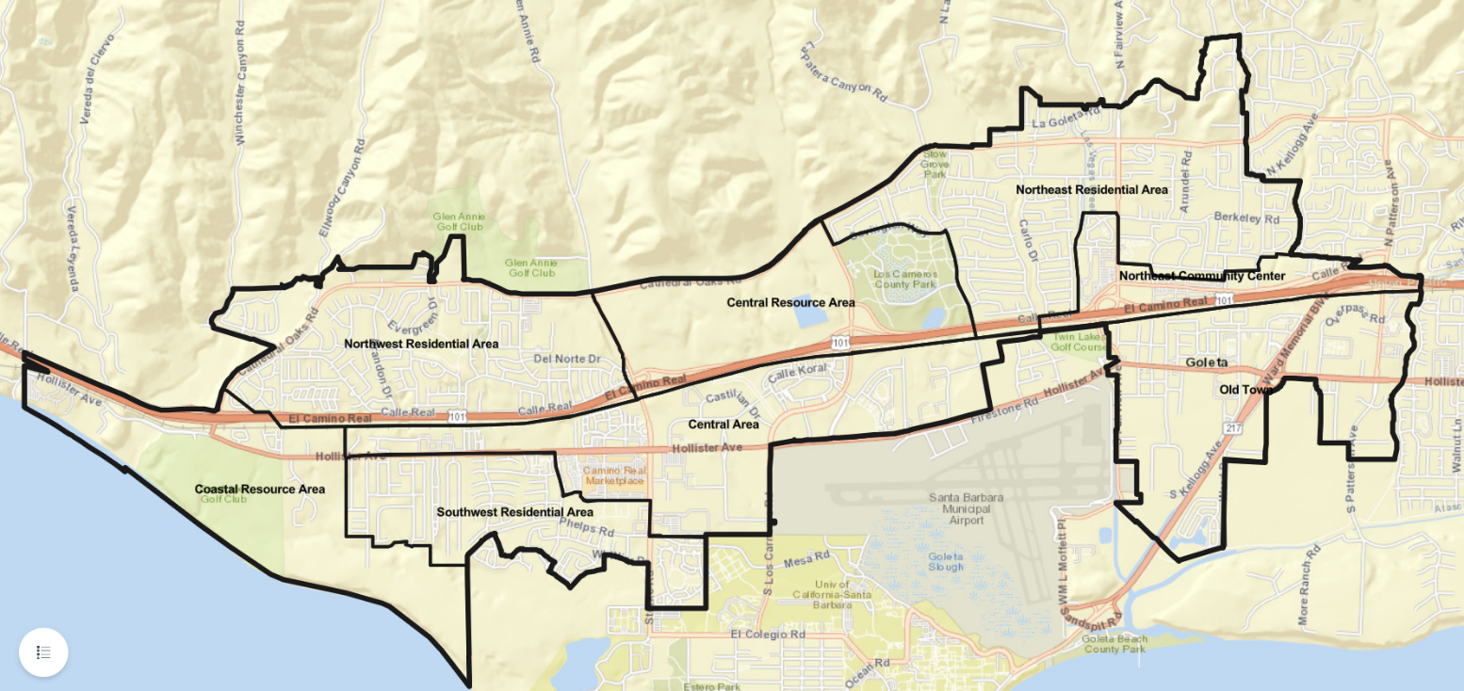
Communities of Interest
General Plan Subareas (more helpful as organizing frameworks)
General Plan Subareas
  Central Area
  Central Resource Area
  Coastal Resource Area
  Northeast Community Center
  Northeast Residential Area
  Northwest Residential Area
  Old Town
  Southwest Residential Area

Slide 3
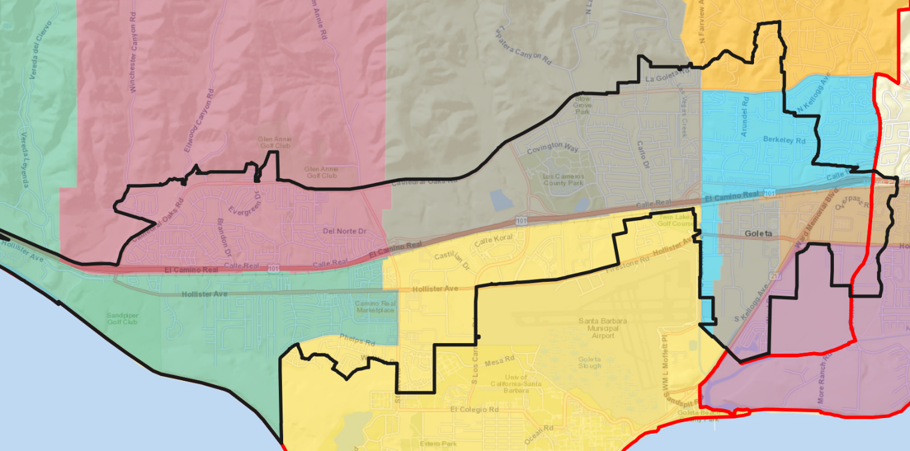
Communities of Interest
Elementary School Attendance Areas
  Brandon (pink)
  El Camino (brown)
  Ellwood (green)
  Hollister (purple)
  Isla Vista (yellow)
  Kellogg (blue)
  La Patera (gray)
  Mountain View (orange)

Slide 4
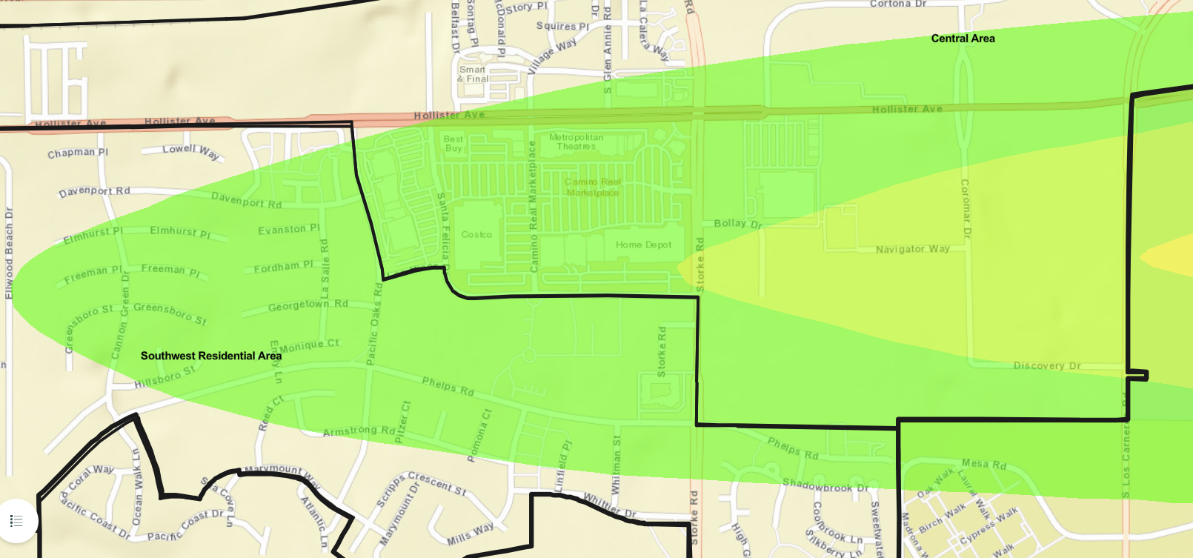
Communities of Interest
Airport Noise Corridor
  From Hollister Ave in the north to Phelps Rd in the south
  From Los Carneros Rd in the east to Cannon Green Dr in the west

Slide 5
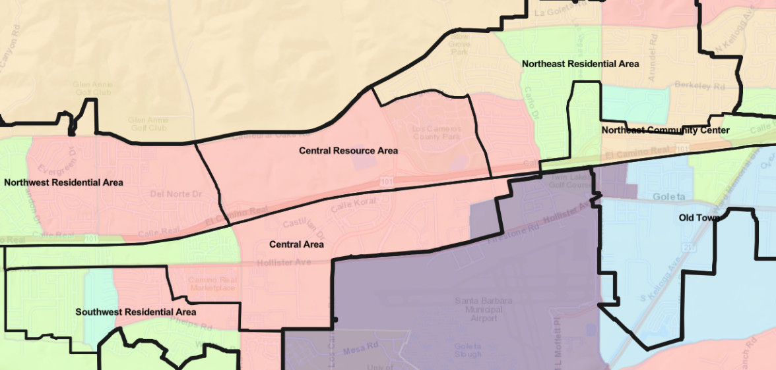
Communities of Interest
Demographic Outliers
  Ellwood Beach/Mathilda: Lower income, more multi-family housing, more renter housing
  Encina Royale: Older, fewer with children at home
  Old Town: More Spanish speakers, more with children at home, lower income, fewer college educated, more multi-family housing, more renters

Slide 6
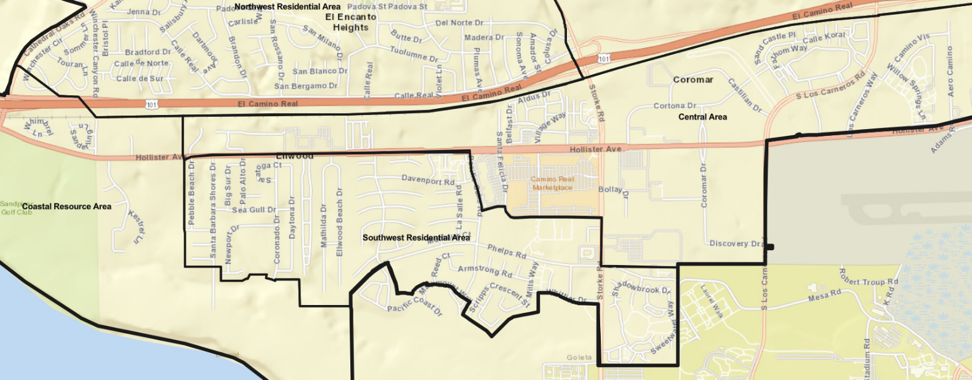
Neighborhoods (Central Area)
  The Bluffs
  Ellwood Station
  Eucalyptus Grove
  The Hideaway/Sanderling
  Hollister Village
  La Calera/Pacific Glen
  Mariposa at Ellwood Shores
  The Village at Los Carneros/Elacora
  Wayside Village (Mobile Home Park)
  Willow Springs

Slide 7
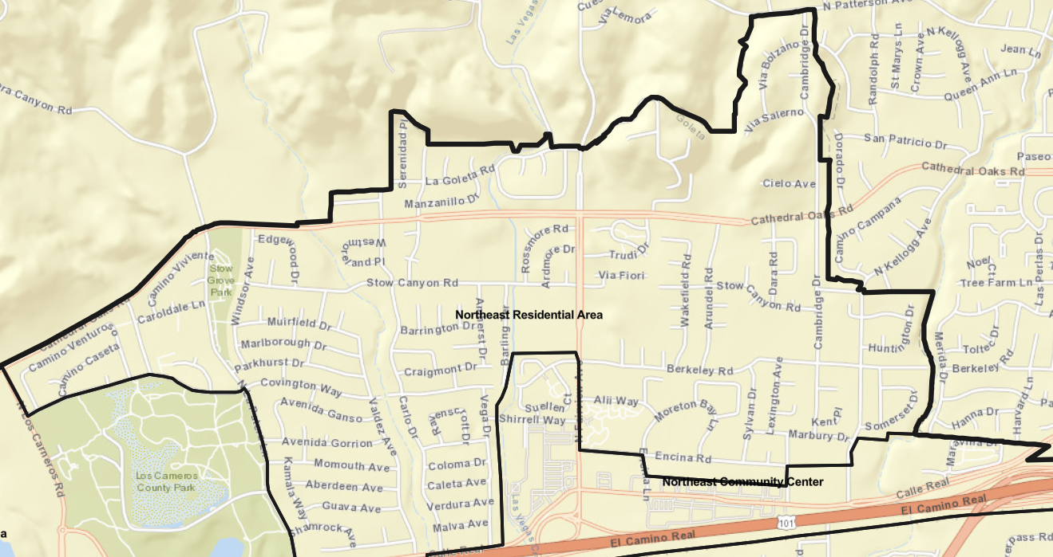
Neighborhoods (Northeast Area)
  Berkeley/Cambridge/Kellogg
  Carlo/Vega
  Encina Royale
  La Goleta
  Lake Los Carneros East
  Lake Los Carneros North
  Maravilla
  Suellen
  Village Terrace

Slide 8
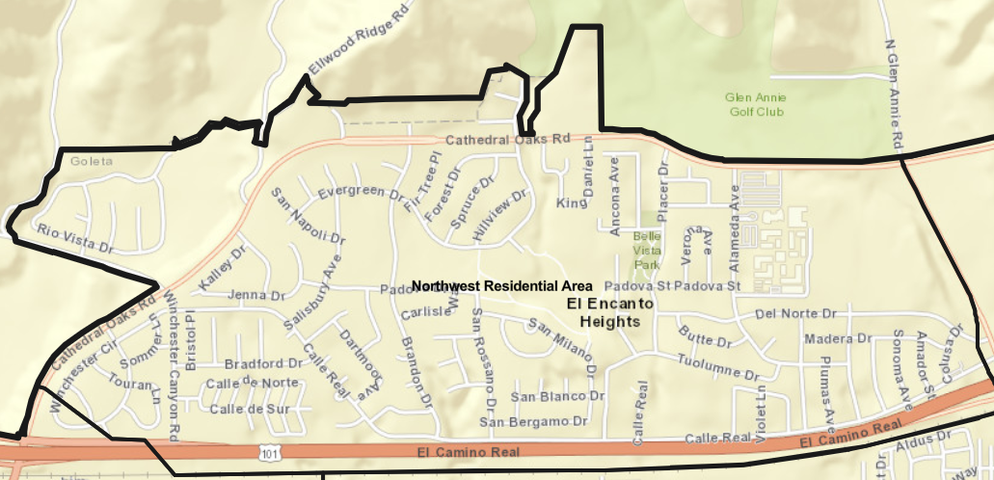
Neighborhoods (Northwest Area)
  Brandon/Evergreen
  Dos Pueblos/El Encanto Heights
  Evergreen Terrace
  Mountain View Ranch
  Santa Barbara West (Mobile Home Park)
  Winchester Canyon/
  San Miguel
  Winchester Commons

Slide 9
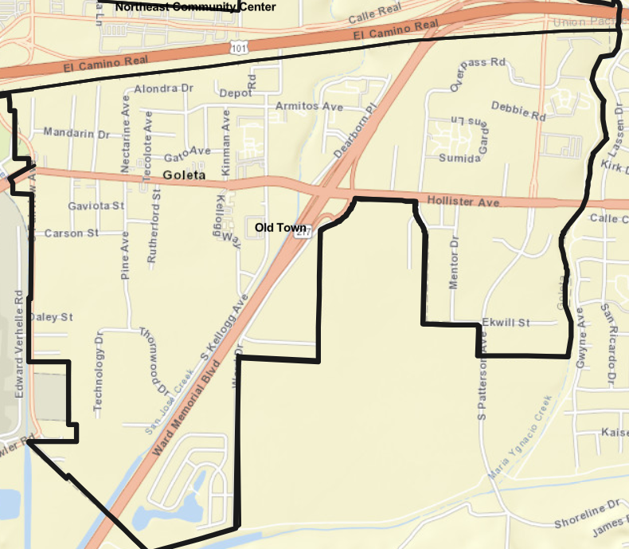
Neighborhoods (Old Town)
  Dearborn Green
  /La Goleta
  Old Town Proper
  Patterson Place
  /Overpass Rd.
  Rancho Goleta (Mobile Home Park)
  Sumida Gardens
  Winslowe

Slide 10
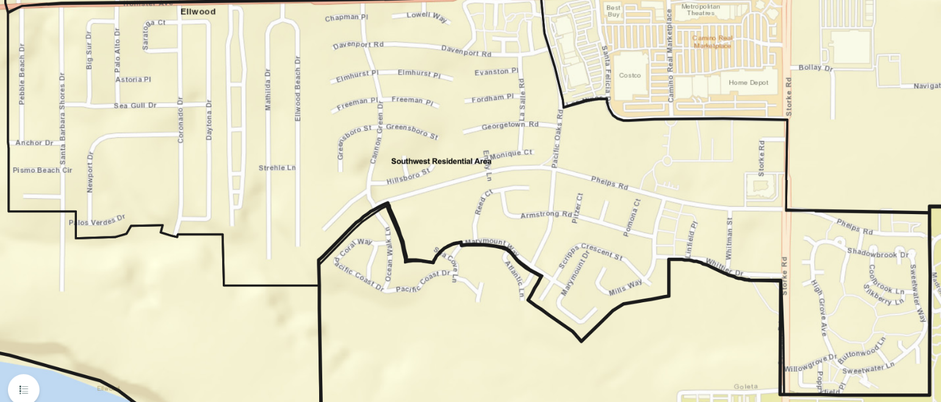
Neighborhoods (Southwest Area)
  Armstrong/Scripps Cresc.
  Cannon Green
  Ellwood Beach/Mathilda
  Ellwood Mesa/Coronado
  Meadow Tree/Santa Barbara Fairways
  Pacific Oaks
  Rancho Estates (Mobile Home Park)
  Santa Barbara Shores
  Sesame Tree/Whittier
  Storke Ranch

