Slide 1
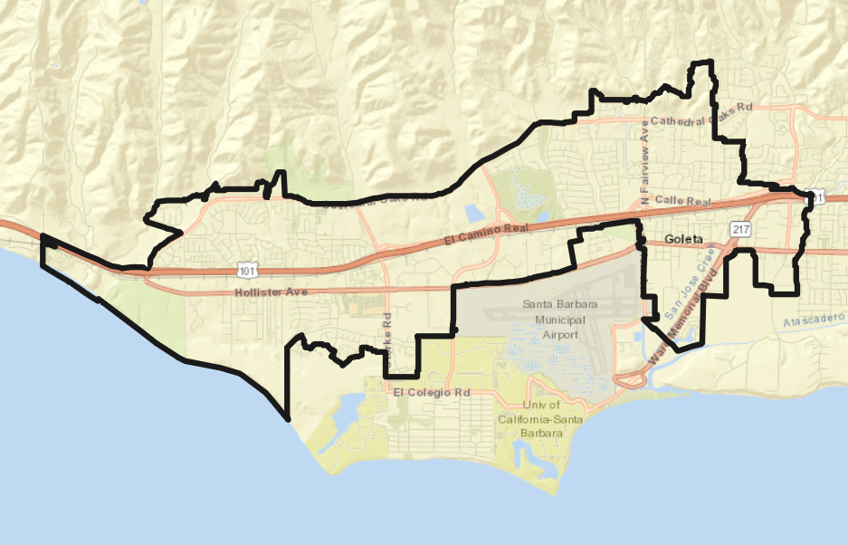
City of Goleta
Public Workshop on Districting

Slide 2
Election Systems
“At Large”
“From District”
“By District”
The California Voting Rights Act was written to specifically encourage by-district elections

Slide 3
Districting Process
Dates | Step and Description
May 16, 2017 | Resolution of Intent: The City adopted a Resolution of Intent to transition from an at-large system to a by-district system in time for the 2022 election.
April 1, 2020 | 2020 Census: The Census collected information on the population living in Goleta on this date.
Feb. 17, Apr. 22, 2021 | Public Engagement Commission Meetings: The Commission was educated on the process and provided input.

Slide 4
Districting Process, cont.
Dates | Step and Description
June 7, 26, August 2, 2021 | Public Workshops: The public was educated on the process and provided input. First workshop virtual, second and third in person. Third workshop also serves as Pre-Draft Hearing #1.
August 2 & 17, 2021 | Two Pre-Draft Map Hearings: Two meetings held prior to release of draft maps. The public and council are asked to identify “neighborhoods” and “communities of interest.” Second hearing taking place during a regular City Council meeting.
Aug. 19, Nov. 4, Dec. 9, 2021 | Public Engagement Commission Meetings: The Commission will receive an update on the process, and host additional workshops to inform and educate the public on contributing to the process, including drawing their own maps.

Slide 5
Districting Process, cont.
Dates | Step and Description
Sep. 20, 2021 | Statewide Database Data Release: The prisoner-adjusted California Statewide Database will release its official redistricting data.
January 6, 2022 | Deadline for Public Map Submissions: Deadline for the public to submit draft maps for inclusion in the next hearing packet and presentation.
January 24, 2022 | Release of Draft Maps: Initial draft maps posted to project website.

Slide 6
Districting Process, cont.
Dates | Step and Description
January 26, 2022 | Public Engagement Commission Meeting: The Commission will consider the maps submitted and to provide input and recommendations to the City Council.
Feb. 1 & 15, 2022 | Two Post-Draft Map Hearings: Two meetings to discuss and revise the draft maps and to discuss the election sequence. Will take place during regular City Council meetings.
March 1, 2022 | Map Adoption: Map adopted via ordinance at a regular City Council meeting. Final map must be posted at least 7 days prior to adoption.

Slide 7
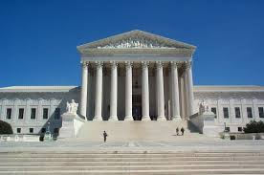
Districting Rules and Goals
1. Federal Laws
2. California Criteria for
Cities
3. Other Traditional Districting Principles
Equal Population
Federal Voting Rights Act
No Racial Gerrymandering
Geographically contiguous
Undivided neighborhoods and “communities of interest”
(Socio-economic geographic areas that should be kept together)
Easily identifiable boundaries
Compact
(Do not bypass one group of people to get to a more distant group of people)
Prohibited:
“Shall not favor or discriminate against a political party.”
Respect voters’ choices / continuity in office
Future population growth

Slide 8
Demographic Summary
Each of the 4 districts must contain about 8,190 people.
Check out the Story Map for maps of some of this demographic data.

Slide 9
Communities of Interest & Neighborhoods Identified by the City Council
The City Council has recognized a list of communities of interest and neighborhoods to respect
This establishes a record of important areas that should be kept undivided in the map-drawing process, to the extent practicable
Not necessarily an exhaustive list, but intended as a starting point
What follows are maps showing each of those areas that have been identified

Slide 10
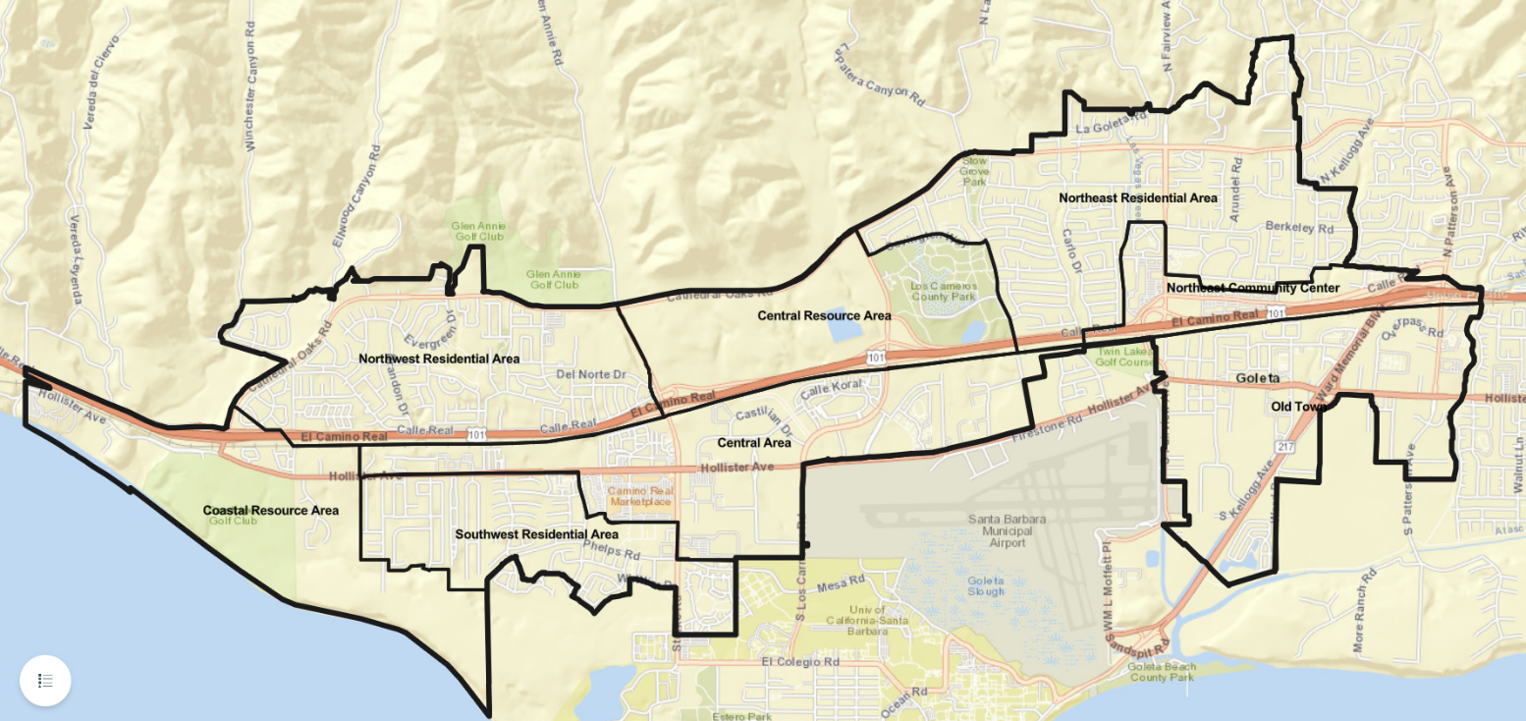
Communities of Interest
General Plan Subareas (more helpful as organizing frameworks)
General Plan Subareas
  Central Area
  Central Resource Area
  Coastal Resource Area
  Northeast Community Center
  Northeast Residential Area
  Northwest Residential Area
  Old Town
  Southwest Residential Area

Slide 11
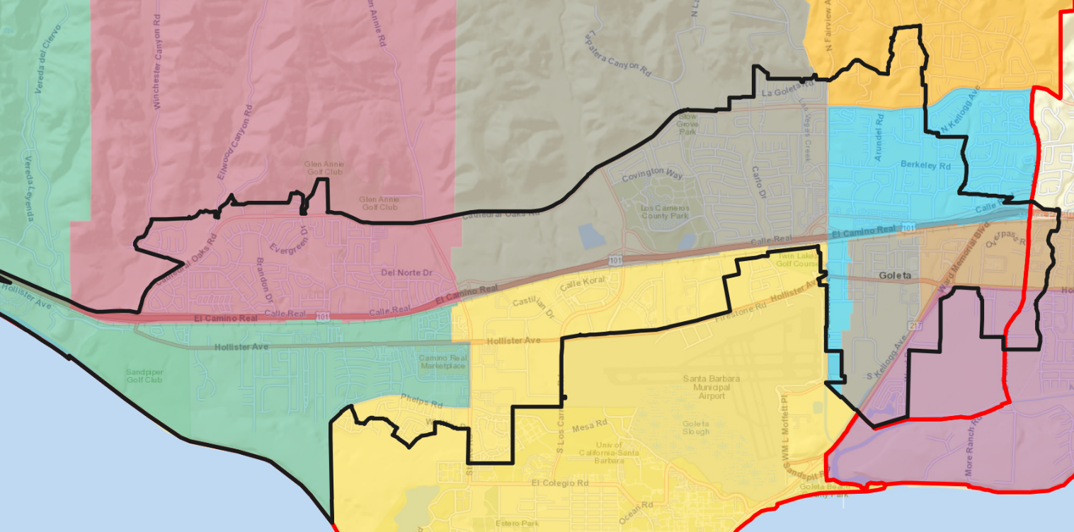
Communities of Interest
Elementary School Attendance Areas
  Brandon (pink)
  El Camino (brown)
  Ellwood (green)
  Hollister (purple)
  Isla Vista (yellow)
  Kellogg (blue)
  La Patera (gray)
  Mountain View (orange)

Slide 12
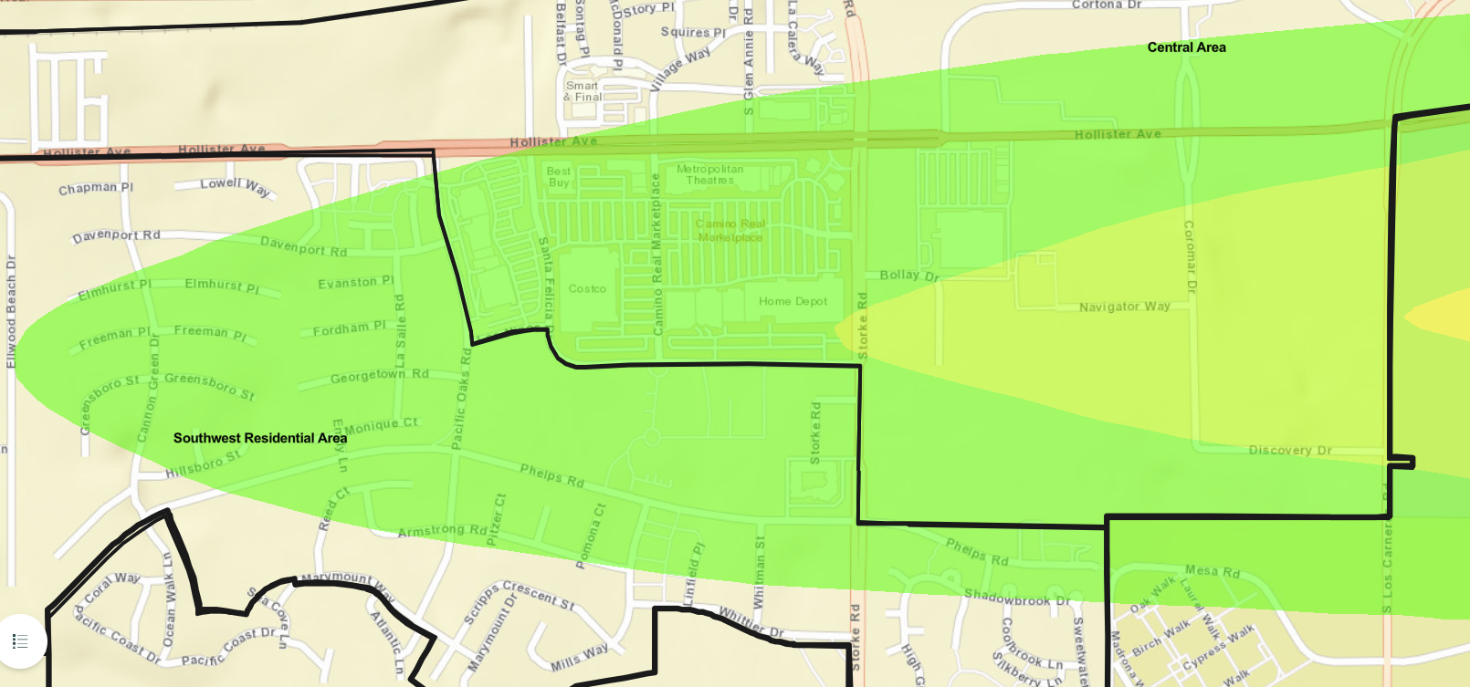
Communities of Interest
Airport Noise Corridor
  From Hollister Ave in the north to Phelps Rd in the south
  From Los Carneros Rd in the east to Cannon Green Dr in the west

Slide 13
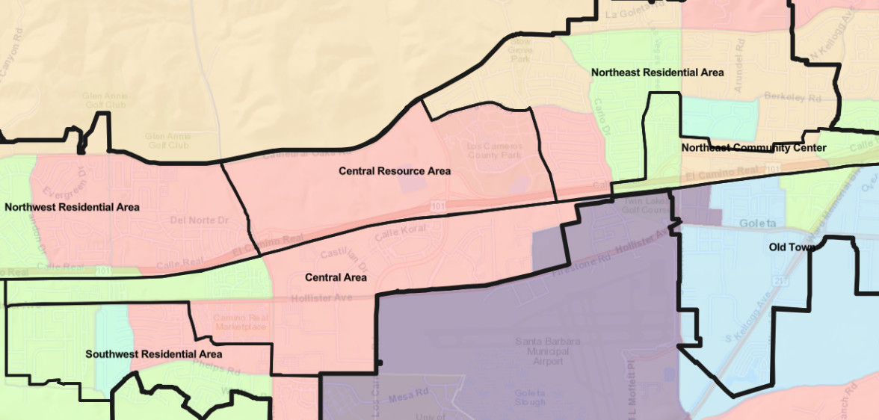
Communities of Interest
Demographic Outliers
  Ellwood Beach/Mathilda: Lower income, more multi-family housing, more renter housing
  Encina Royale: Older, fewer with children at home
  Old Town: More Spanish speakers, more with children at home, lower income, fewer college educated, more multi-family housing, more renters

Slide 14
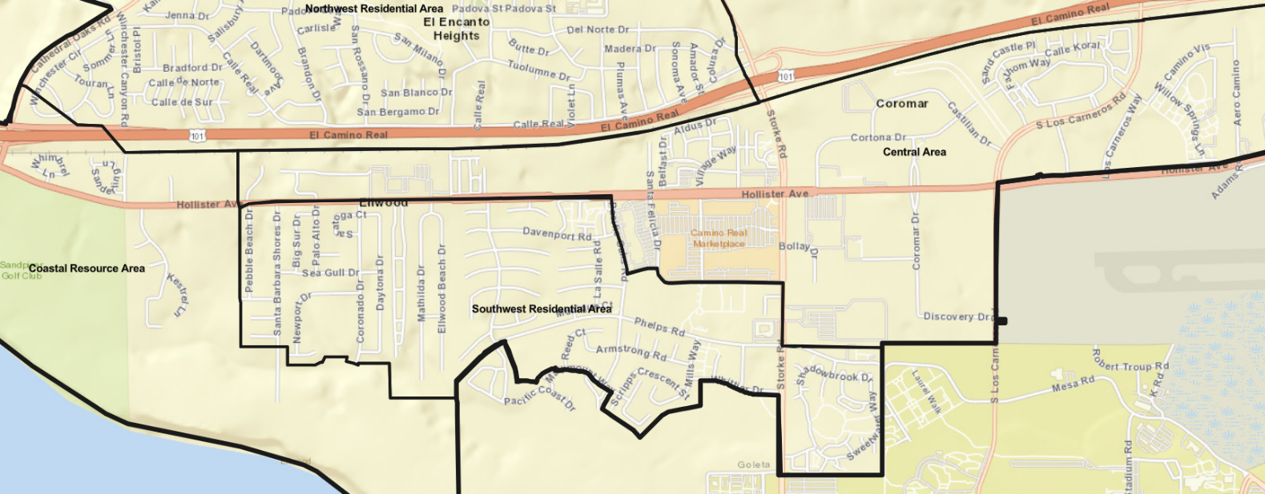
Neighborhoods (Central Area)
  The Bluffs
  Ellwood Station
  Eucalyptus Grove
  The Hideaway/Sanderling
  Hollister Village
  La Calera/Pacific Glen
  Mariposa at Ellwood Shores
  The Village at Los Carneros/Elacora
  Wayside Village (Mobile Home Park)
  Willow Springs

Slide 15
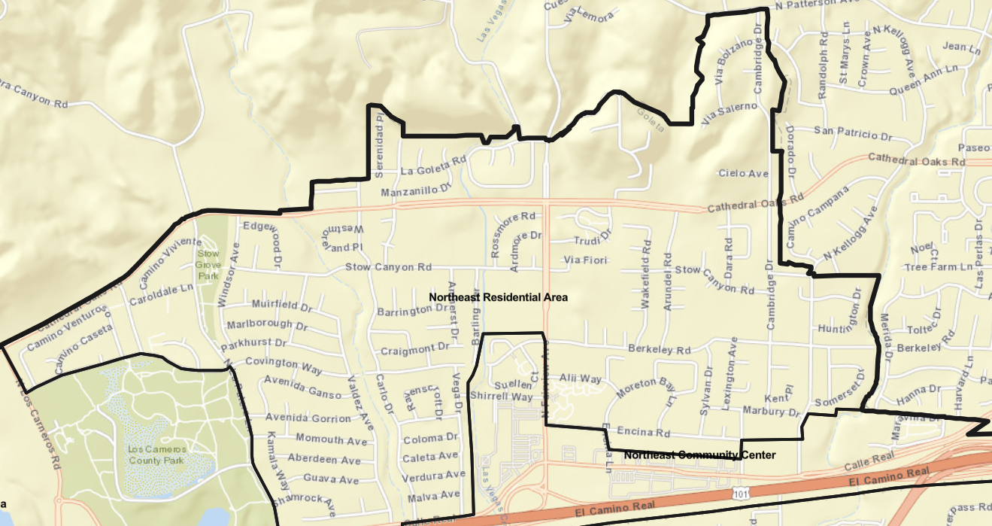
Neighborhoods (Northeast Area)
  Berkeley/Cambridge/Kellogg
  Carlo/Vega
  Encina Royale
  La Goleta
  Lake Los Carneros East
  Lake Los Carneros North
  Maravilla
  Suellen
  Village Terrace

Slide 16
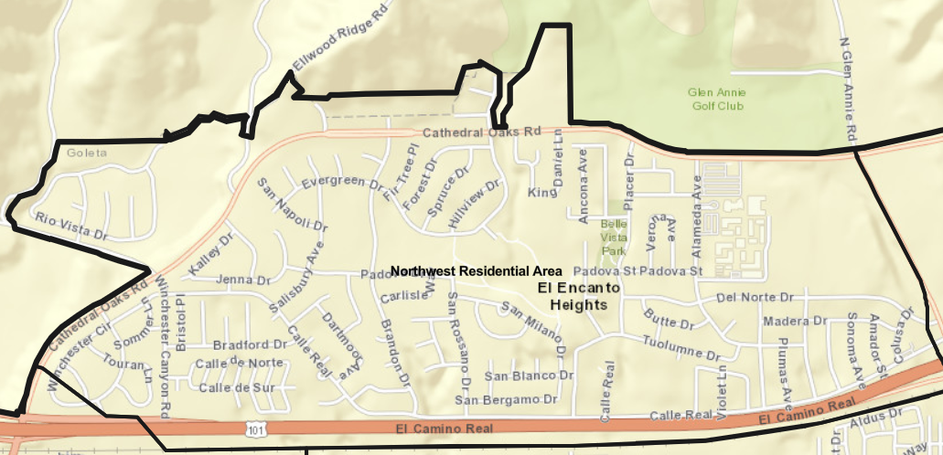
Neighborhoods (Northwest Area)
  Brandon/Evergreen
  Dos Pueblos/El Encanto Heights
  Evergreen Terrace
  Mountain View Ranch
  Santa Barbara West (Mobile Home Park)
  Winchester Canyon/
  San Miguel
  Winchester Commons

Slide 17
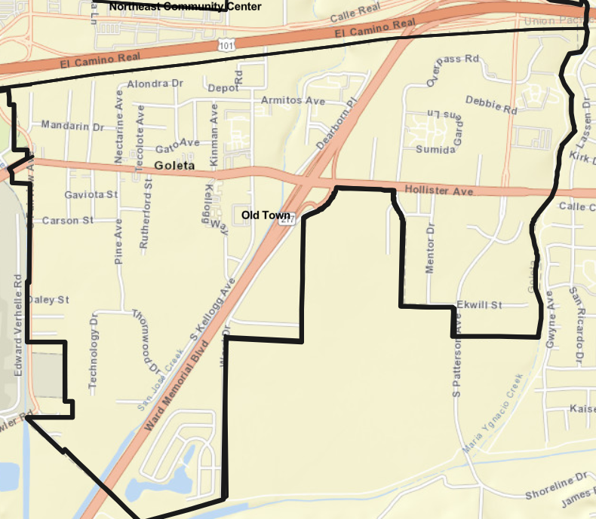
Neighborhoods (Old Town)
  Dearborn Green
  /La Goleta
  Old Town Proper
  Patterson Place
  /Overpass Rd.
  Rancho Goleta (Mobile Home Park)
  Sumida Gardens
  Winslowe

Slide 18
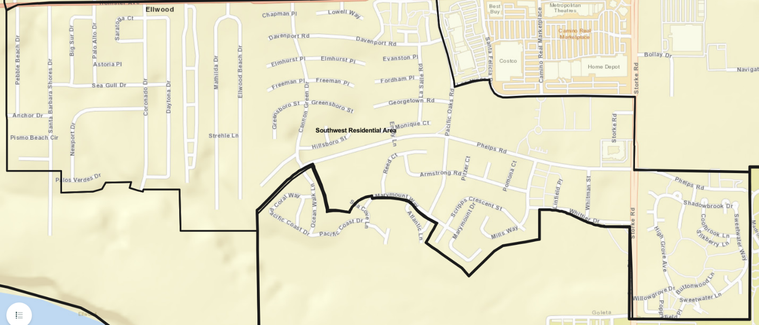
Neighborhoods (Southwest Area)
  Armstrong/Scripps Cresc.
  Cannon Green
  Ellwood Beach/Mathilda
  Ellwood Mesa/Coronado
  Meadow Tree/Santa Barbara Fairways
  Pacific Oaks
  Rancho Estates (Mobile Home Park)
  Santa Barbara Shores
  Sesame Tree/Whittier
  Storke Ranch

Slide 19
Public Mapping and Map Review Tools
Different tools for different purposes
Different tools for different levels of comfort and interest, found at drawgoleta.org/draw-a-map
  Simple “learn about your community” Story Map
  Simple “review draft maps” Interactive Review Map
  Paper- and Excel-based simple “Draw a draft map” tools
  Easy-to-use online “Draw your neighborhood” / “Draw a draft map” tool: DistrictR
  More complex but powerful “Draw a draft map” tool: Caliper’s Maptitude Online Redistricting (MOR)
Whether you use the online mapping tool, Excel, the paper kit, or just draw on a napkin, we welcome your maps!

Slide 20
Making Sure That Your Map is Balanced
Given that the mapping tools were only recently updated with the official population data, any plans submitted using the estimated population data may not be population balanced according to the official population data, even if they appeared to be so according to the estimated population data
To guarantee that your DistrictR map is balanced, you must start a new drawing by clicking the purple button “built out of 2020 blocks”; if you click on your original version that you made with the estimated data and try to edit that, it will not adjust for the new official data, but continue to use the estimated data
If you would like to use your original version as a template, you can have that open in another tab and try to do your best to replicate it as you make a new drawing
Once you are done, make sure to select “Share Now” to save it to the Public Gallery; drafts are not shared with the Council

Slide 21
Making Sure That Your Map is Balanced
When you are using DistrictR, please be mindful of what the percentage value displayed at the bottom right side of the page is showing you
It is showing the maximum population deviation, or the most a single district deviates from the ideal
We are looking for plans that have a total population deviation less than 10%
Having a maximum population deviation that is less than 10% does not mean that the total population deviation is less than 10%
So to be safe, aim for a maximum population deviation that is under 5%

Slide 22
Public Discussion
Any questions about the mapping tools?
Please visit the website for more information: drawgoleta.org

