Slide 1
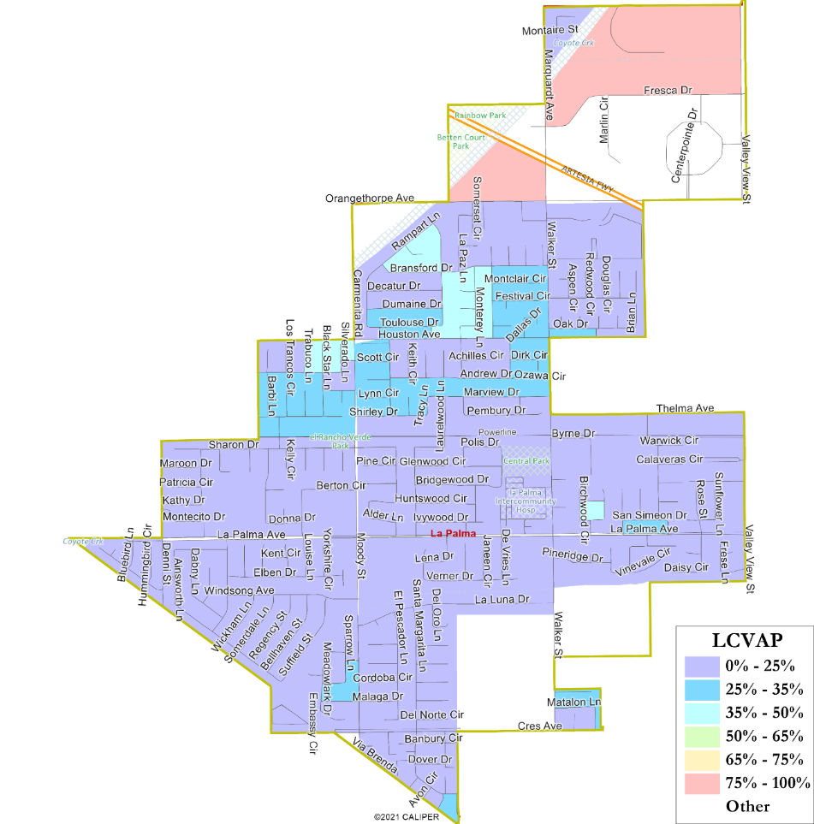
City of La Palma
Community Workshop on District Elections
Justin Levitt, Vice-President
National Demographics Corporation (NDC)

Slide 2
Election Systems
“At Large”
“From District” or “Residence” Districts
“By District”
The California Voting Rights Act was written to specifically encourage by-district elections.

Slide 3
California Voting Rights Act (CVRA)
Under the Federal Voting Rights Act (passed in 1965), a jurisdiction must fail 4 factual tests before it is in violation of the law.
The California VRA makes it significantly easier for plaintiffs to force jurisdictions into “by-district” election systems by eliminating two of the US Supreme Court Gingles tests:
  Can the protected class constitute the majority of a district?
  Does the protected class vote as a bloc?
  Do the voters who are not in the protected class vote in a bloc to defeat the preferred candidates of the protected class?
  Do the “totality of circumstances” indicate race is a factor in elections?
Liability is now determined only by the presence of racially polarized voting

Slide 4
CVRA Impact
Switched (or in the process of switching) as a result of CVRA:
  At least 240 school districts
  34 Community College Districts
  Over 165 cities
  1 County Board of Supervisors
  35 water and other special districts.
Cases So Far:
  Palmdale, Santa Clara and Santa Monica went to trial on the merits. Palmdale and Santa Clara lost. Santa Monica is awaiting a decision.
  Modesto and Palmdale each spent about $1.8 million on their defense (in addition to the attorney fee awards in those cases).
  Santa Monica has spent an estimated $7 million so far. Plaintiffs in Santa Monica requested $22 million in legal fees after the original trial.
Key settlements:
  Palmdale: $4.7 million
  Modesto: $3 million
  Highland: $1.3 million
  Anaheim: $1.1 million
  Whittier: $1 million
  Santa Barbara: $600,000
  Tulare Hospital: $500,000
  Camarillo: $233,000
  Compton Unified: $200,000
  Madera Unified: about $170,000
  Hanford Joint Union Schools: $118,000
  Merced City: $42,000
An estimated $16 million in total settlements and court awards so far.

Slide 5
Districting Timeline
Step | Description
Public Hearing 1 May 3, 2022 | Overview of Process, Outreach Preview, Communities of Interest; Community Feedback.
Public Hearing 2 May 17, 2022 | Map Drawing Criteria, Communities of Interest; Mapping Tools; Community Feedback.
Community Workshop June 21, 2022 | Map Drawing Criteria, Communities of Interest; Mapping Tools; Community Feedback.
Deadline for Maps June 23, 2022 | Deadline for maps to be submitted for the July 5th Hearing
Maps Published June 28, 2022 | Maps must be posted 7 days prior to the public hearing at which they are discussed
Public Hearing 3 July 5, 2022 | Hearing to look at the first round of draft maps, discuss and revise the draft maps, and to discuss the election sequence.
Revised Maps Published July 26, 2022 | Maps must be posted 7 days prior to the public hearing at which they are discussed
Public Hearing 4 August 2, 2022 | Hearing to look at the second round of draft maps, discuss and revise the draft maps, and to discuss the election sequence.
Public Hearing 5/ Selection of Map September 6, 2022 | Introduce ordinance & first reading to establish by-district elections.

Slide 6
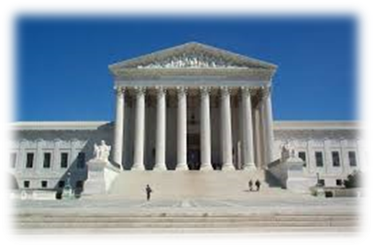
Redistricting Rules and Goals
1. Federal Laws
2. California Criteria for
Cities
3. Other Traditional Redistricting Principles
Equal Population
Federal Voting Rights Act
No Racial Gerrymandering
Geographically contiguous
Undivided neighborhoods and “communities of interest”
(Socio-economic geographic areas that should be kept together)
Easily identifiable boundaries
Compact
(Do not bypass one group of people to get to a more distant group of people)
Prohibited:
“Shall not favor or discriminate against a political party.”
Respect voters’ choices / continuity in office
Future population growth

Slide 7
Key Demographics
The courts view Citizen Voting Age Population data as the best available measure of “eligible voters.”
With 5 districts (& rotating mayor), each district should have 3,120 residents.

Slide 8
Demographic Summary
These additional demographic data can be used to identify “communities of interest” in the districting process.

Slide 9

Latino Population
Latinos are slightly concentrated around Houston Ave.
The large pink blocks have few people.

Slide 10
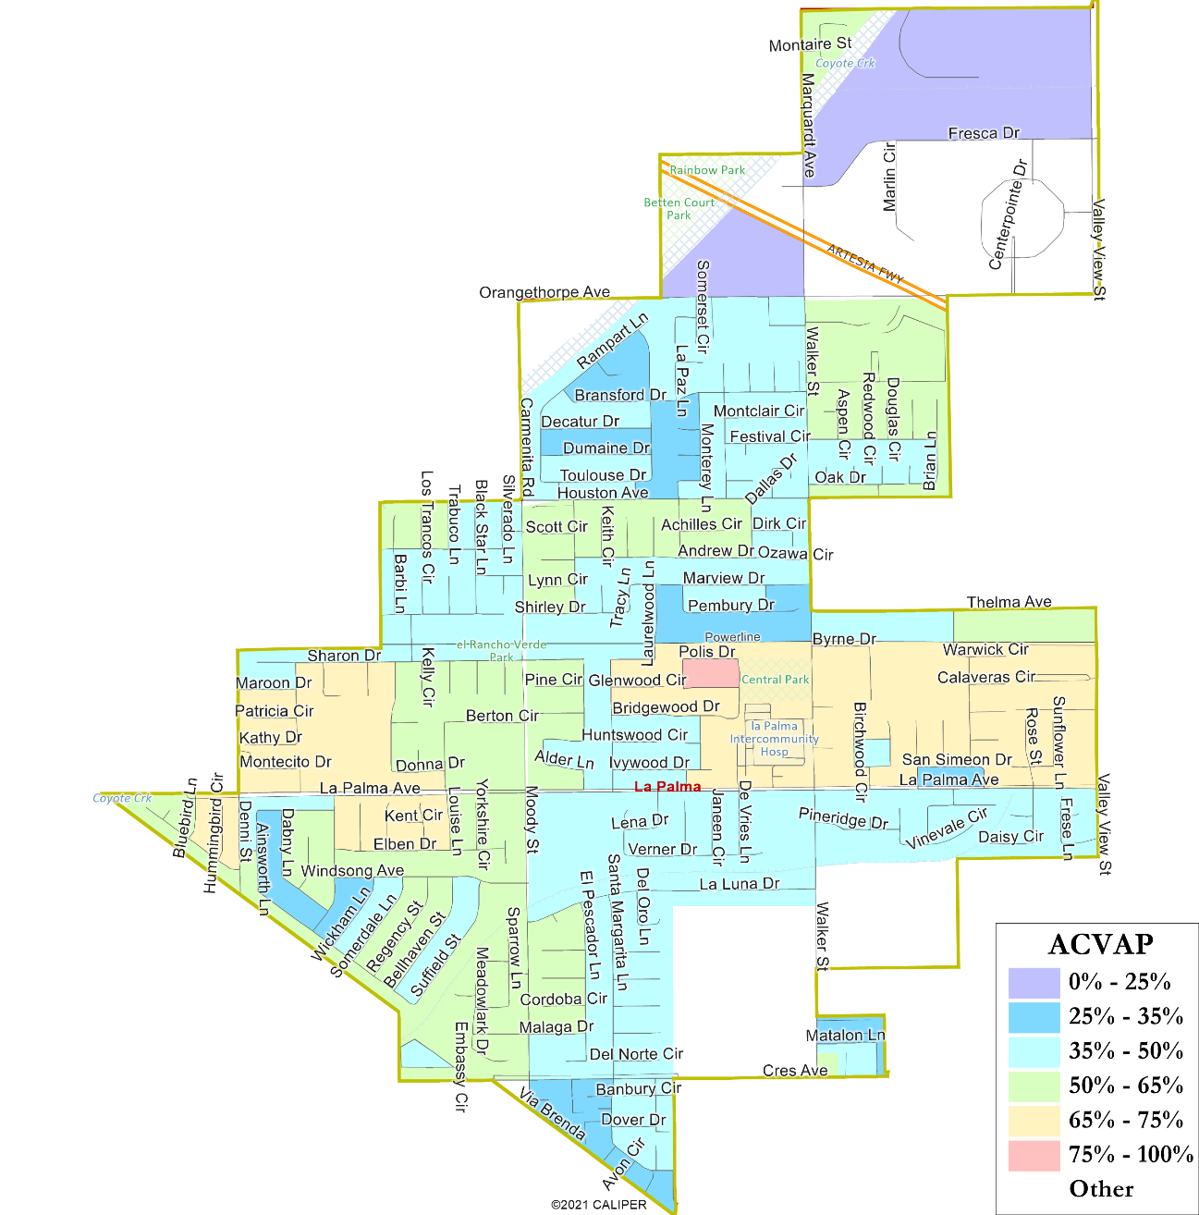
Asian Population
Asian-Americans are particularly concentrated in central La Palma around La Palma Avenue
There are no large geographic concentrations of African-Americans or Native Americans.

Slide 11

Defining Neighborhoods
1st Question: What is your neighborhood?
2nd Question: What are its geographic boundaries?
Examples of physical features defining a neighborhood boundary:
Natural neighborhood dividing lines, such as highway or major roads, rivers, canals and/or hills
Areas around parks or schools
Other neighborhood landmarks
In the absence of public testimony, planning records and other similar documents may provide definition.

Slide 12
Beyond Neighborhoods:
Defining Communities of Interest
1st Question: What defines your community?
Geographic Area, plus
Shared issue or characteristic
  Shared social or economic interest
  Impacted by city policies
Tell us “your community’s story”
2nd Question: Would this community benefit from being “included within a single district for purposes of its effective and fair representation”?
Or would it benefit more from having multiple representatives?
Definitions of Communities of Interest may not include relationships with political parties, incumbents, or political candidates.

Slide 13
Public Mapping and Map Review Tools
Different tools for different purposes
Different tools for different levels of technical skill and interest
  Simple “review draft maps” tool
  Easy-to-use “Draw your neighborhood” tool
  Paper “Draw a draft map” tool
  Powerful, data-rich “Draw a draft map” tool
Whether you use the online mapping tool, the paper kit,
or just draw on a napkin, we welcome your maps!

Slide 14
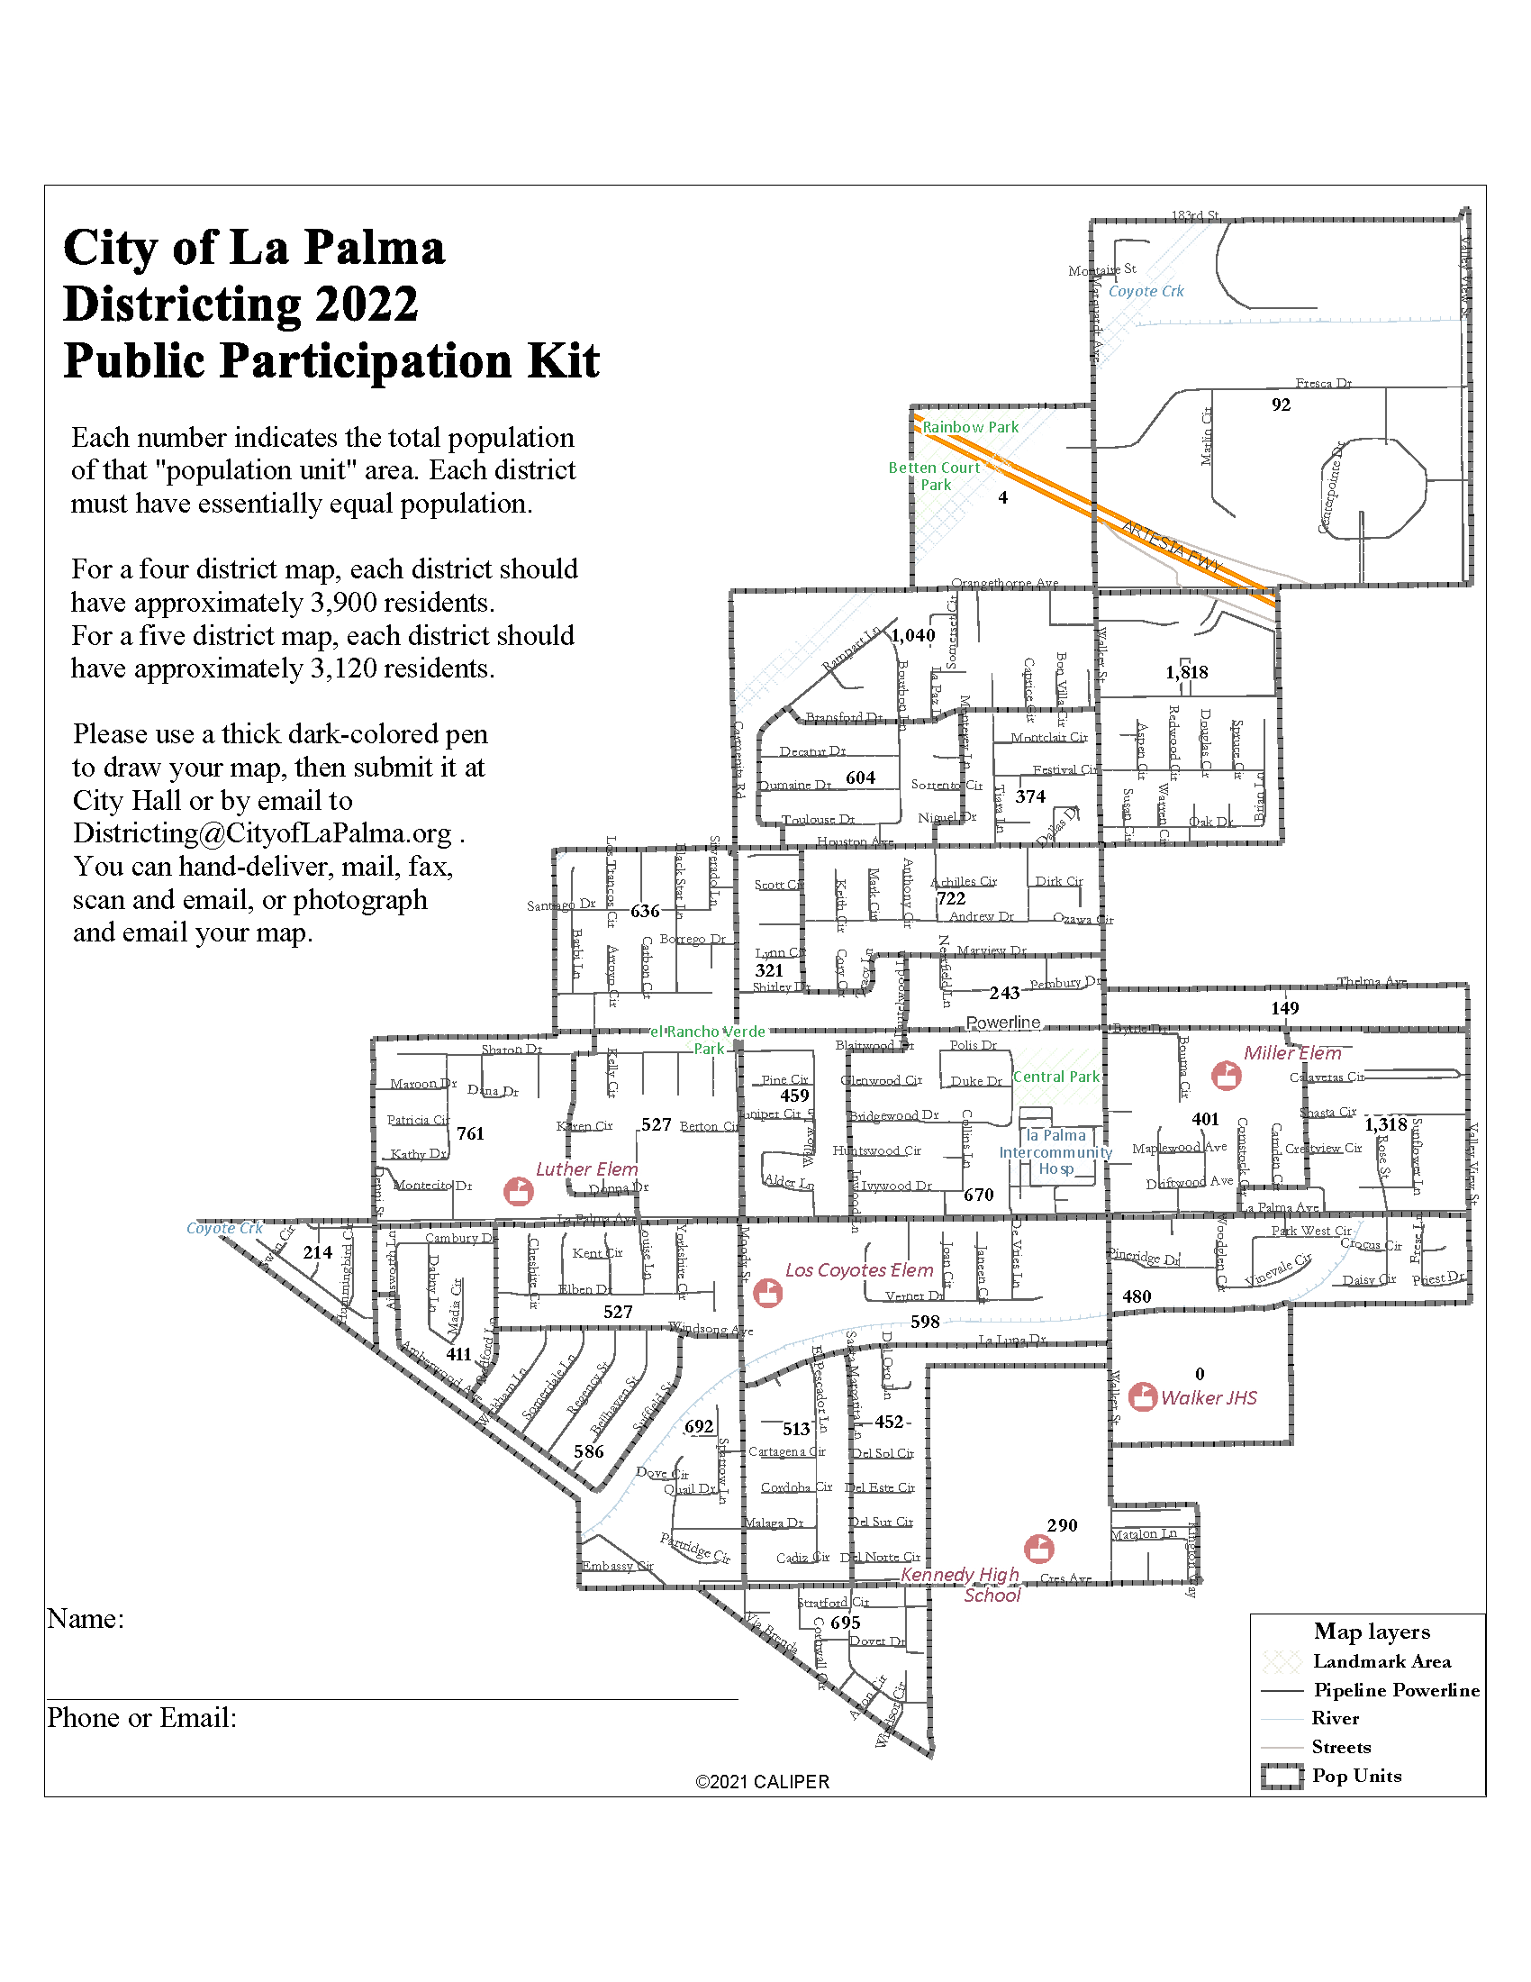
Simple Map Drawing Tool
Paper “Public Participation Kit”
For those without internet access or who prefer paper
Total Population Counts only – no demographic numbers

Slide 15
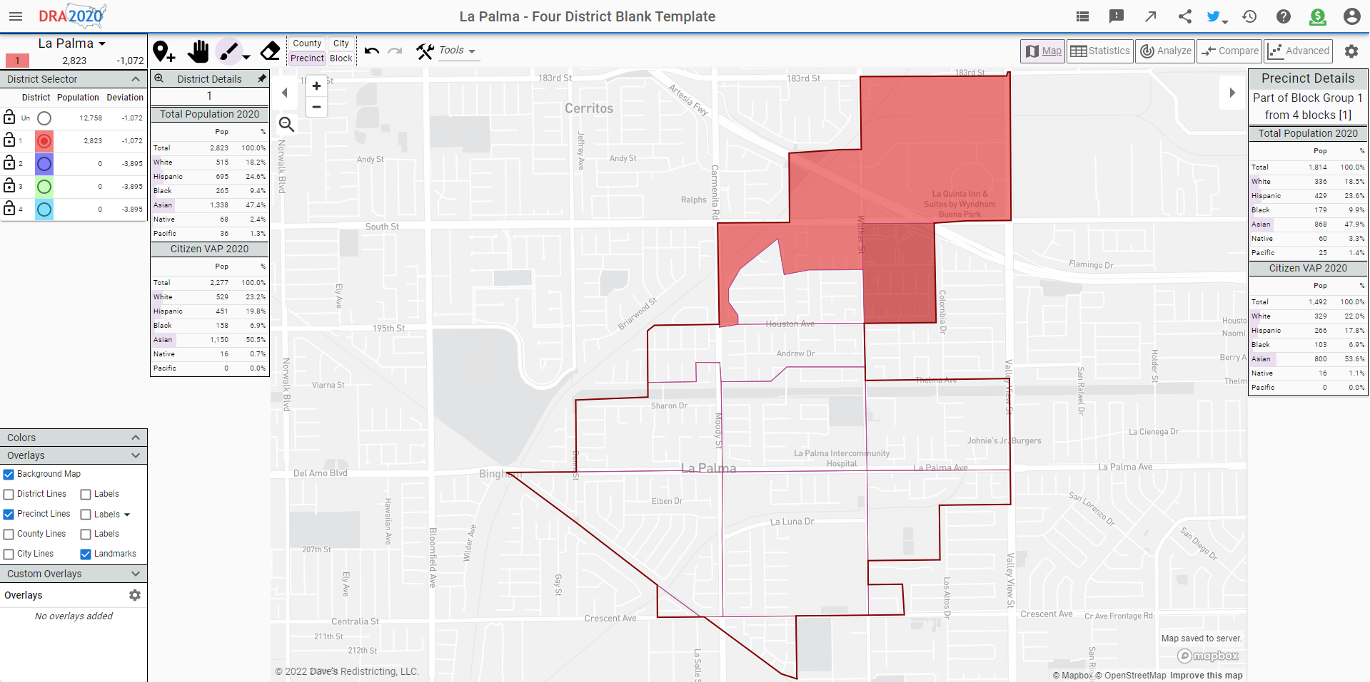
Dave’s Redistricting App (DRA)
DavesRedistricting.org
A powerful but easy-to-use online mapping tool

Slide 16
Public Hearing & Discussion
What is your neighborhood and what are its boundaries?
What other notable areas are in the City, and what are their boundaries?
Any questions about the mapping tools?

Slide 17
Share Your Thoughts
Website
www.CityofLaPalma.org/Districting
Phone
(714) 690-3358
Email
Districting@CityofLaPalma.org

